Slide 1
Financial indicator comparison with model explanation APS 1053
Guided by Prof. Loren Trigo & Prof. Sabatino Costanzo
Prepare by Yunkun (Harris) Yang
Feb 17

Slide 2
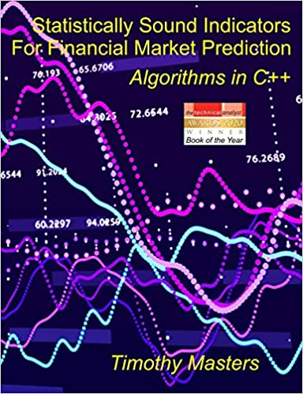
Special Thanks to
Dr. Timothy Masters
http://www.timothymasters.info/
The project highly depends on the resources from book
< Statistically Sound Indicators For Financial Market Prediction: Algorithms in C++>
By Dr. Timothy Masters

Slide 3
Today’s Agenda
Project introduction with setups
Model Analysis and Evaluation
Model Explanation with SHAP
Equity Curve Construction using results
RSI Comparison
Future Work
Q&A & Questions for Dr. Masters!!!
Break
After we come back we will get back to the indicator details.

Slide 4
Project Intro

Slide 5
Introduction
This project is used to analyze whether using different indicators can help us build a better trading system. Machine learning methods is used to predict the returns, and further we can construct our trading system depending on those returns.
A comparison between Timothy indicators and Talib indicators is conducted.
Model explanation is applied on the model with selected indicators to see how the extra information affect the model.
The project can also be found: https://github.com/harrisyang611/timothy_indicator_project
Data Prep and Model sample code in directory: https://github.com/harrisyang611/timothy_indicator_project/blob/master/notebook
With the timothy compiled packages: https://github.com/harrisyang611/timothy_master_indicator

Slide 6
Stocks Used
The data used is from scraped from yahoo finance using yfiance API
The stocks used with their tickers are the following:
"^OEX","^NDX","^RUT","^DJI", ## index
"TSLA","NKE","AMZN","WMT","JPM","GS","BA","CAT","IBM","MSFT","TLT", ## popular ones
"BAC","KO","AAPL","DIS","SBUX” ## some stable stocks noted from the page
https://www.fool.com/investing/stock-market/types-of-stocks/safe-stocks
We selected those tickers on purpose to cover traditional stocks and some mean-reverting stocks.

Slide 7
Data and Model Used
The historical data received from yahoo finance are daily from Jan 2010 to Jan 2022.
The target (target) in the model is a percentage return.
The independent data (input) are past 15 days percentage return.
Baseline models: stock’s percentage returns with periods 1, 2, …, 15
Enhanced Model: baseline model inputs + Timothy Masters version of indicators
Enhanced Model2: baseline model inputs + Talib indicators (RSI)
The reason we used such simple model is because we hope to focus on the effect of the indicators.
We used Scikit-learn ridge regression, random forest and gradient boosting.
SKLearn implementation for RF and GBM are not optimal, but it’s easiest for other students to replicate and refer to.

Slide 8
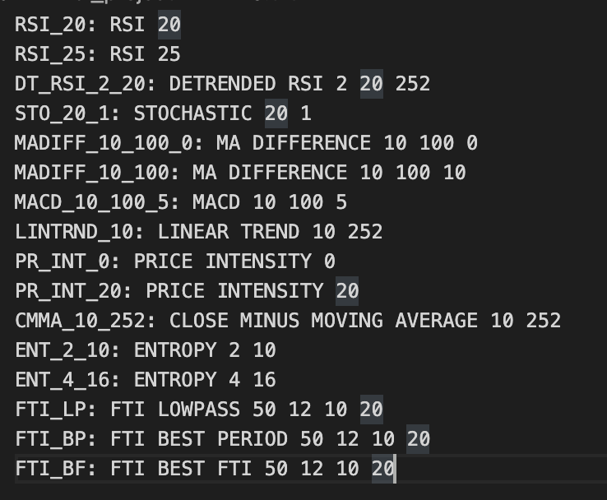
Indicator Used
As stated in the VS.txt file, we include the following indicators:
Detailed in the indicators sections
Why Timothy Masters’ indicator is special? It maximizes the relative entropy!
2 Talib RSI indicators
RSI_20_ta
RSI_25_ta
Those 2 extra indicators are used to compare with
Timothy RSI indicators

Slide 9
Indicators (will come back to this)

Slide 10
Model Evaluation

Slide 11
Baseline Model VS Indicator Models
For the baseline model, basically, we build the model with X = returns and y = future return
For the indicator models, we se X = returns & each single indicator VS y = future return.

Slide 12
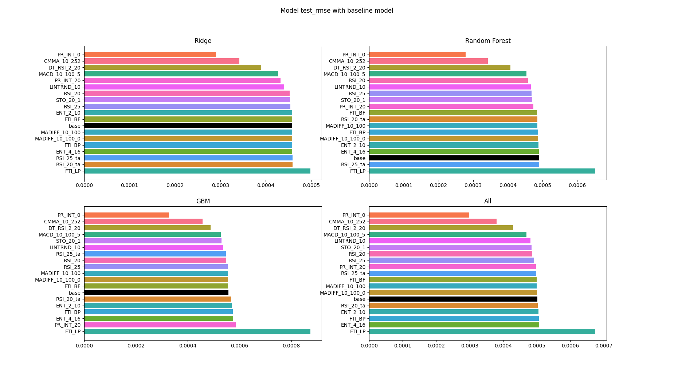
RMSE
This shows how well the models to predict the returns.

Slide 13
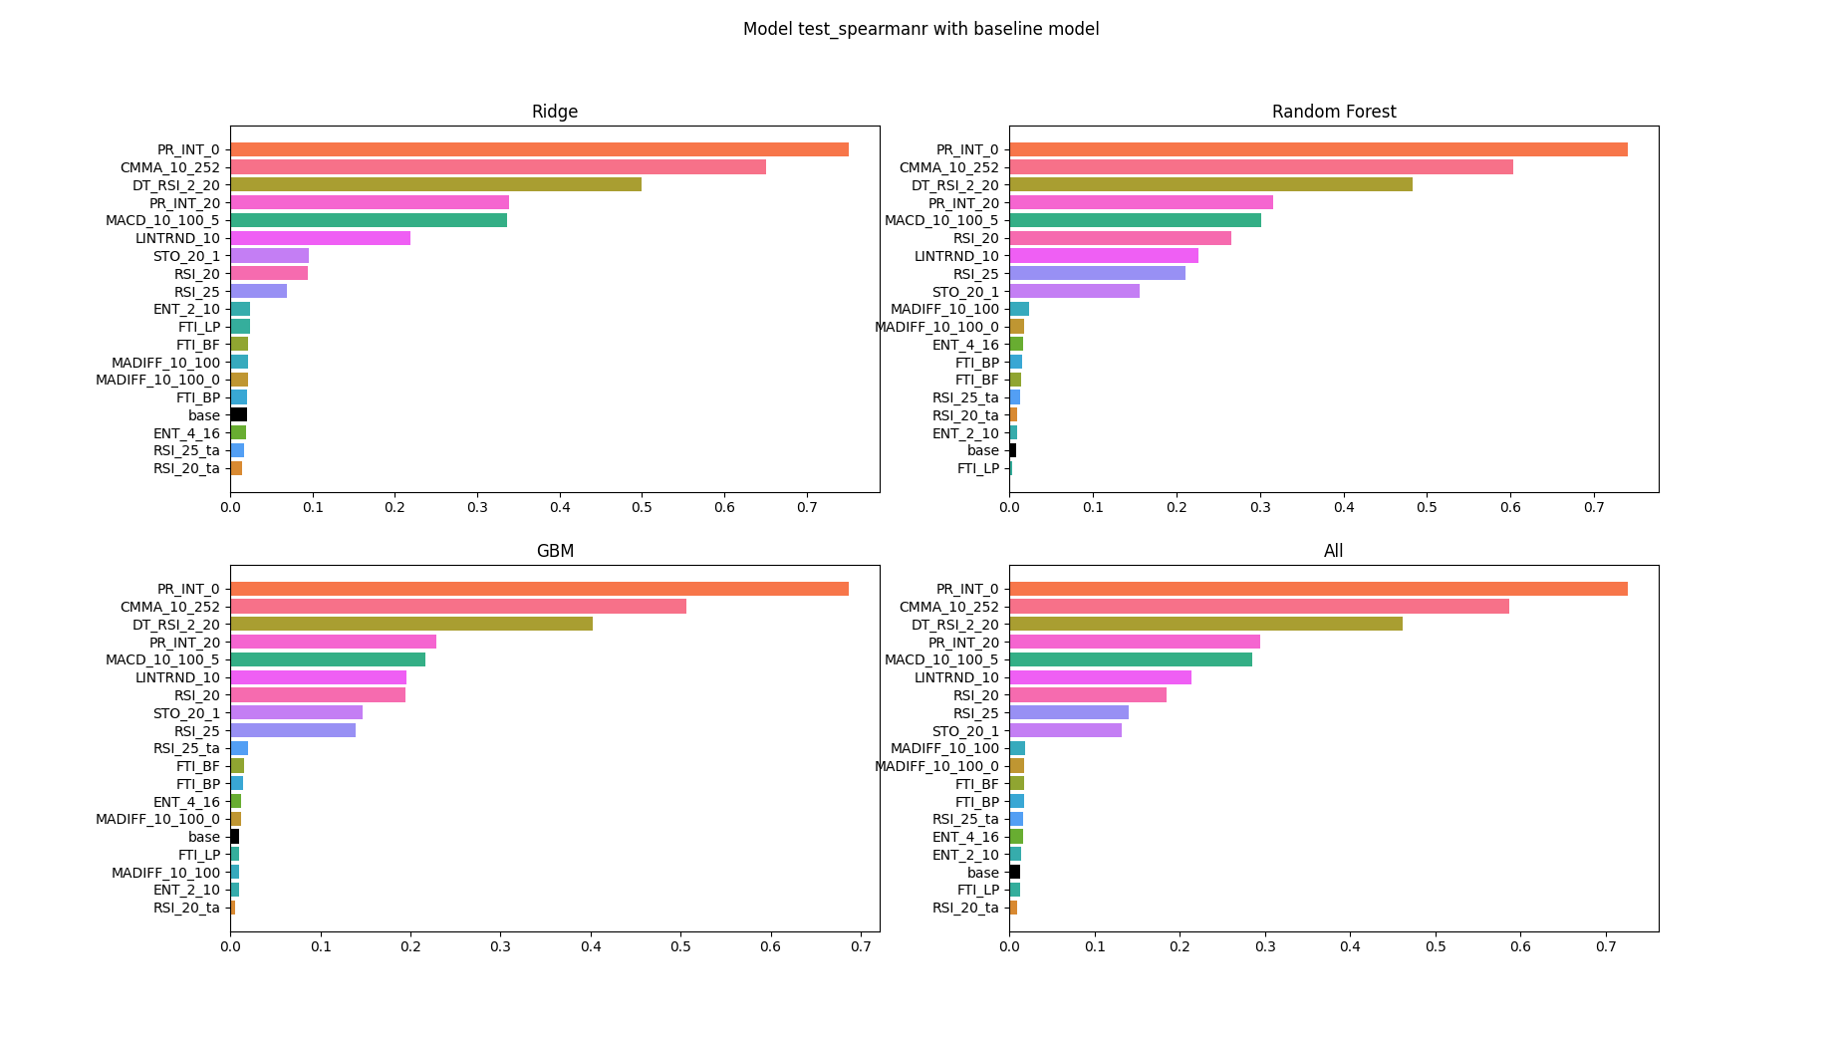
Spearmanr
This shows how correlated the predicted returns and actual returns

Slide 14
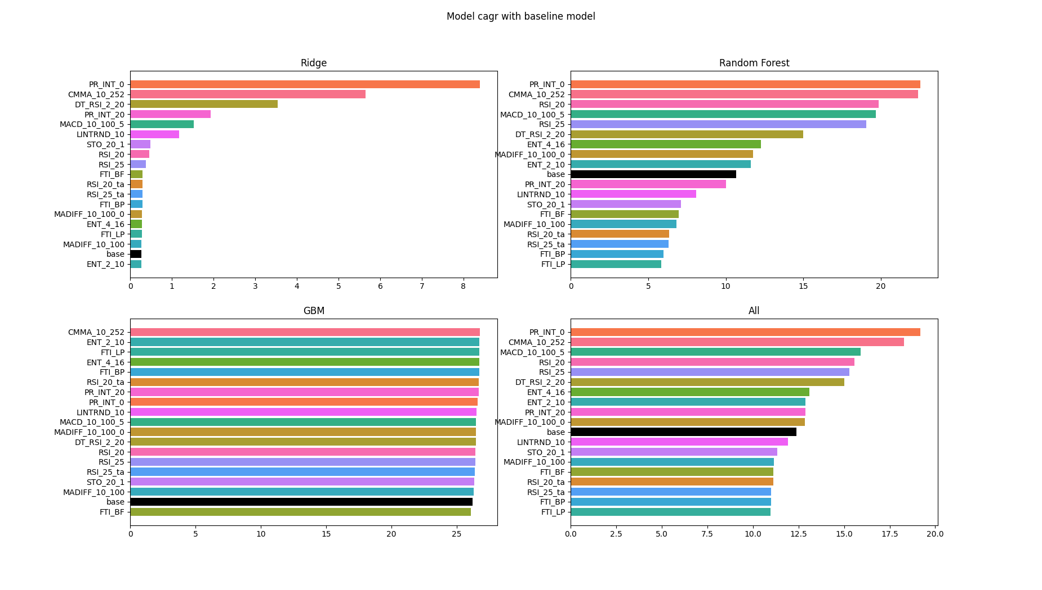
CAGR (Compounded annual growth rate)
This shows how well our predicted return can build the trading system.

Slide 15
Model Explanation

Slide 16
SHAP SHapley Additive exPlanations
SHAP is used to calculate the contribution of each feature to the prediction.
SHAP calculated Shapley values.
It is an additive feature attribution, and it takes the advantage of both LIME(Local Interpretable Model-agnostic Explanation) and Shapley, which only operates on the certain observation.
Lime tweak only one features and see how it affects the predicted values.
LIME is doing well on the observation level.
Sometimes LIME has an issue of out of range (like tweaked values are too different real life)

Slide 17
Shapley
The Shapley value is the average marginal contribution of a feature value across all possible coalitions.
Random permutation of features
Pick a random sample
Take some features value from the random vector and some from the original vector

Slide 18
SHAP
The summary plot shows feature importance with feature effects.
Each point on the summary plot is a Shapley value for a feature and an instance.
The color represents the values of the feature from low to high.
Points are jittered in y-axis direction, so we see the distribution of Shapley values per feature.
Features are ordered according to their importance.

Slide 19
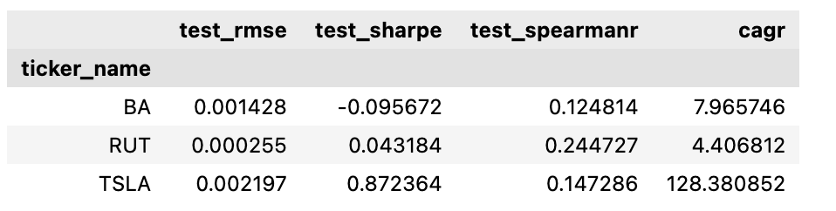
tickers selection
We selected TSLA, RUT, BA, 3 stocks and run the SHAP model because they have highest and lowest CAGR and highest and lowest sharpe ratio respectively.
I will show a few interesting plots from each model to better indicate the SHAP model and the effect of inclusion of new indicators.
TSLA has very high CAGR, but high sharpe ratio shows it has a great volatility.
We noticed that BA( Boeing) has a negative test sharpe ratio, and we know that BA is a mean reversion stock.

Slide 20
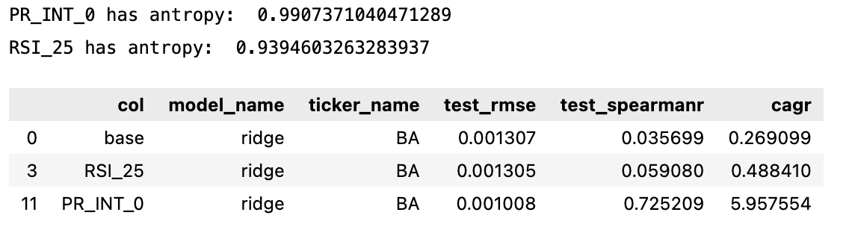
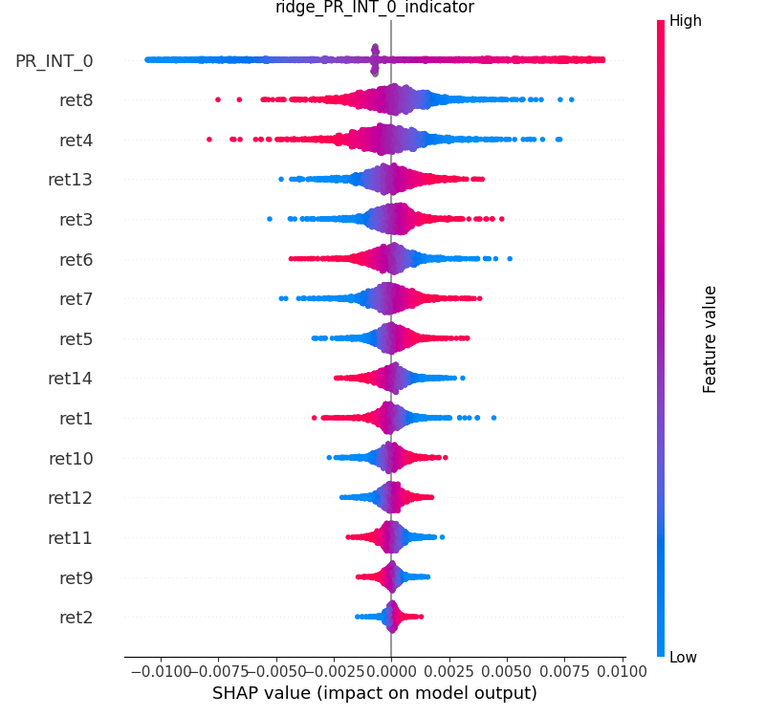
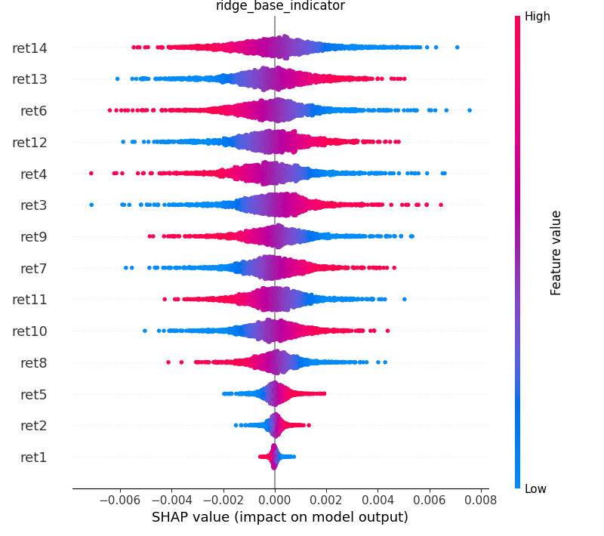
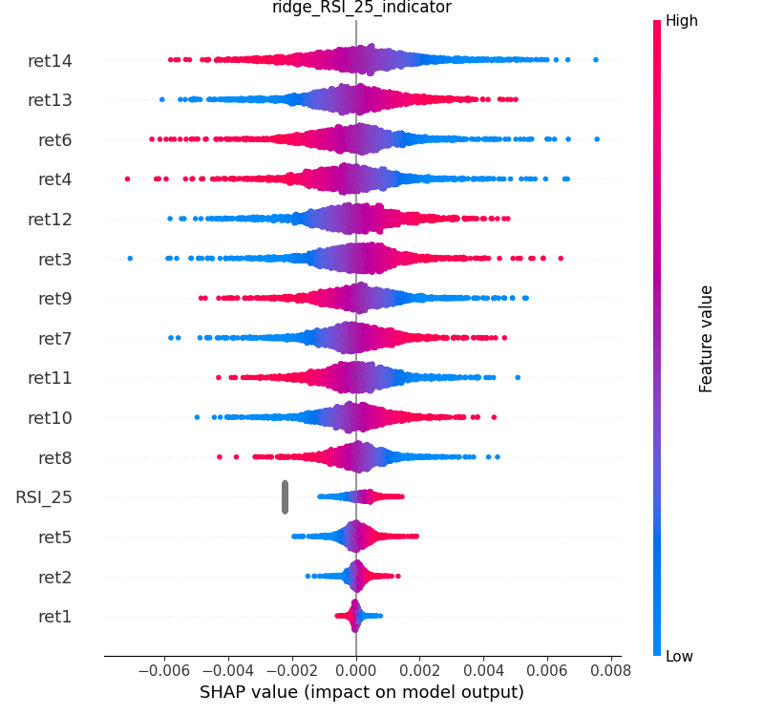
BA Ridge Model

Slide 21
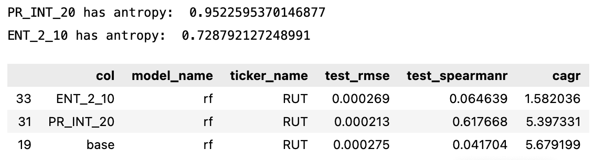
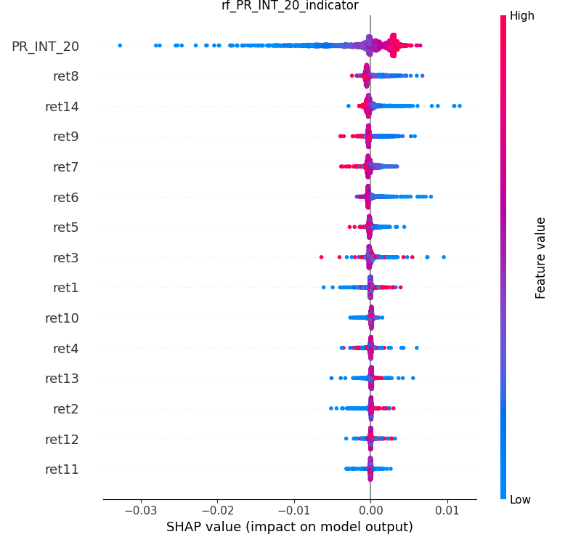
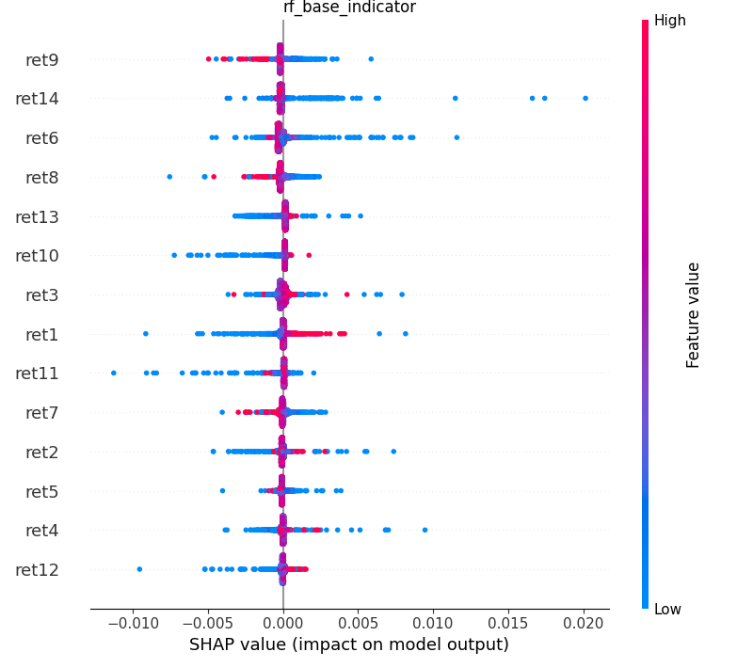
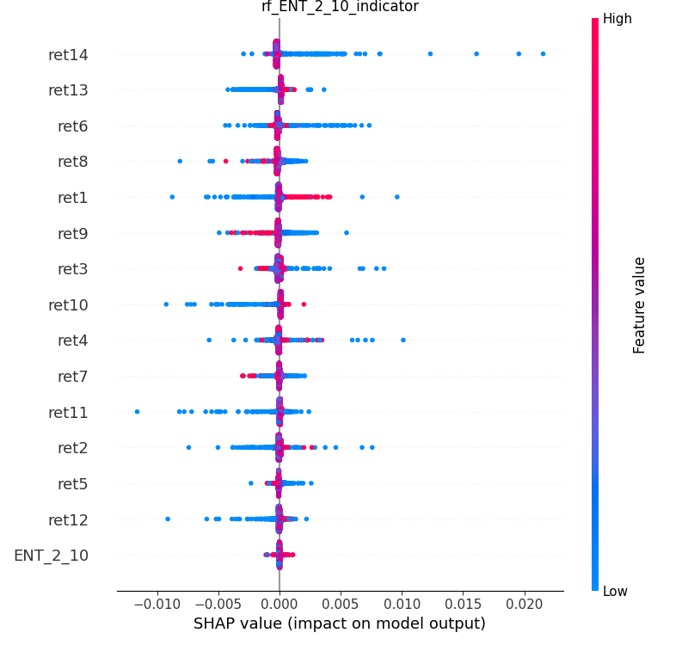
RUT RF Model

Slide 22
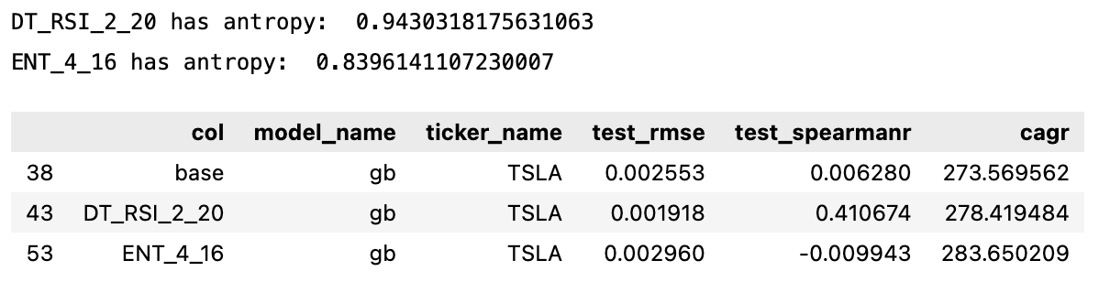
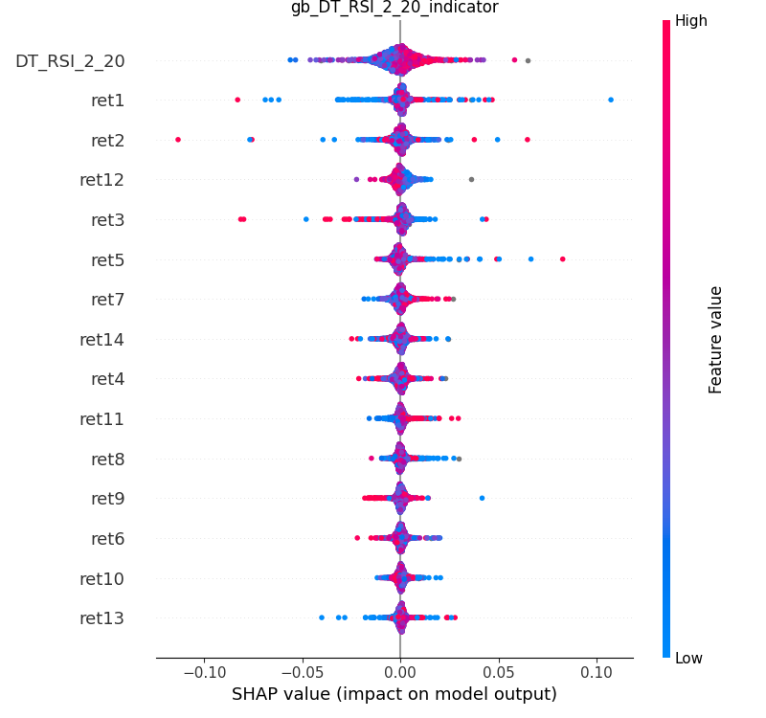
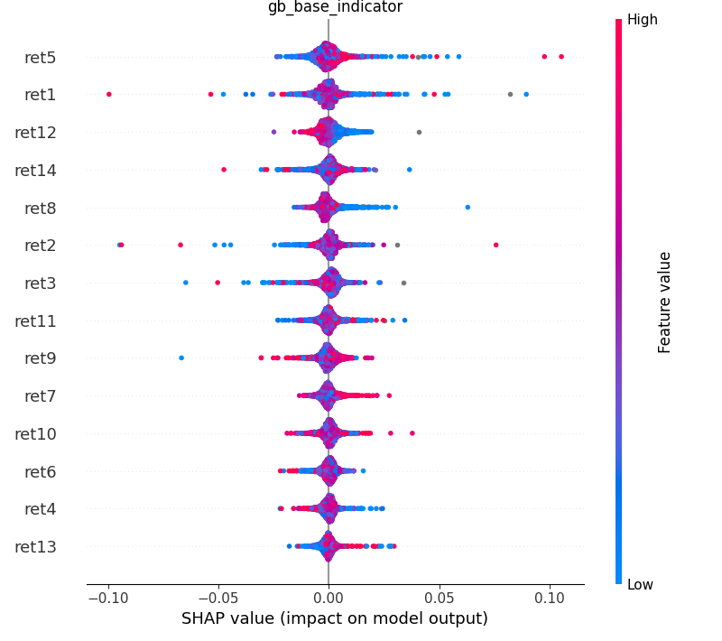
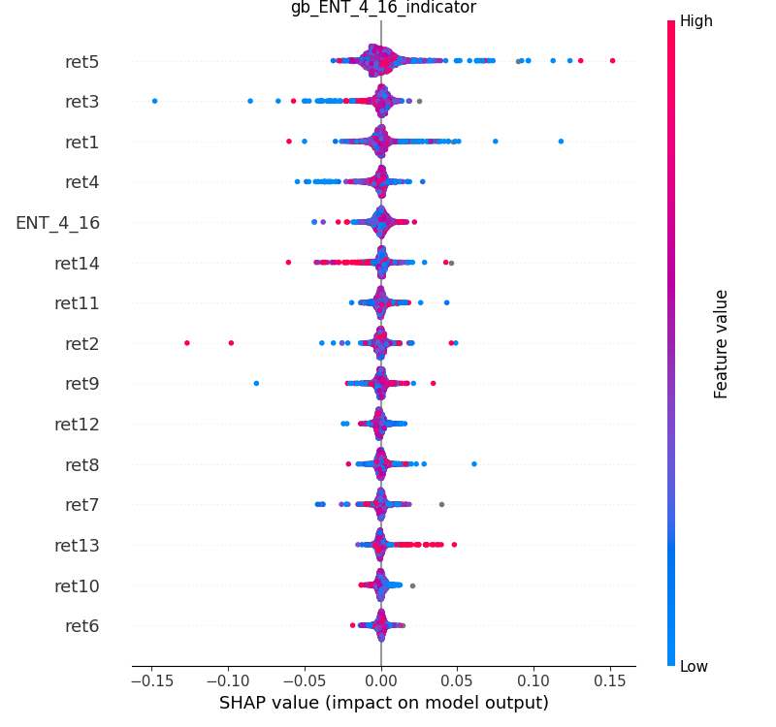
TSLA GB Model

Slide 23
Equity curve

Slide 24
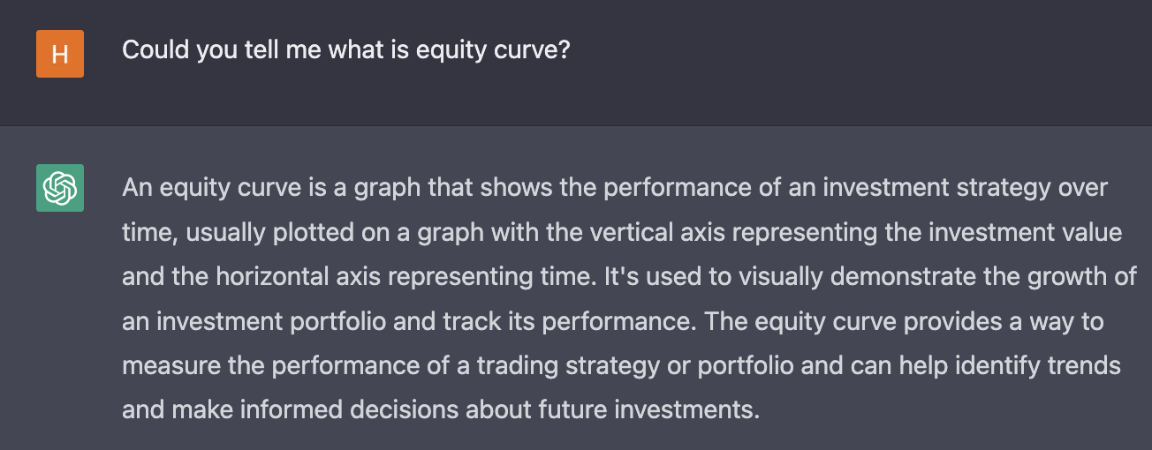
What is equity curve
An equity curve is a graphical representation of the change in the value of an account. An equity curve with a continuous positive slope usually means that the trading strategy is profitable, while a negative slope shows that they are generating a negative return.

Slide 25
We hope to compare the equity curve (trading systems) between models using different indicators, and see which model outperform others, that model (that indicators) would help us to construct a best trading strategy.
I would choose a stock market index (with some trend, but relatively stable) for this case to better show whether our model produces the good result.
Hence we use OEX data with “PR_INT_0” to plot the equity curve.

Slide 26
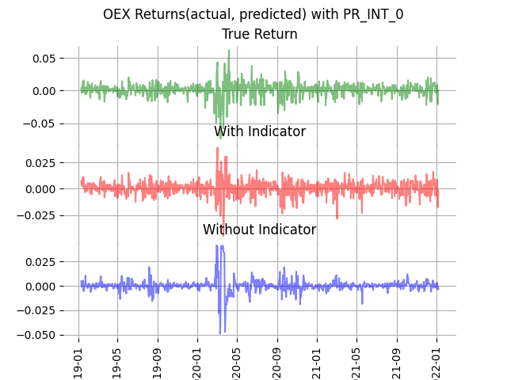
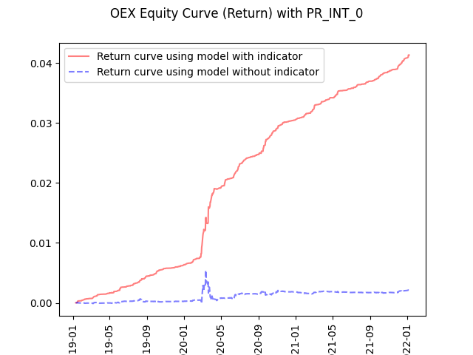

Slide 27
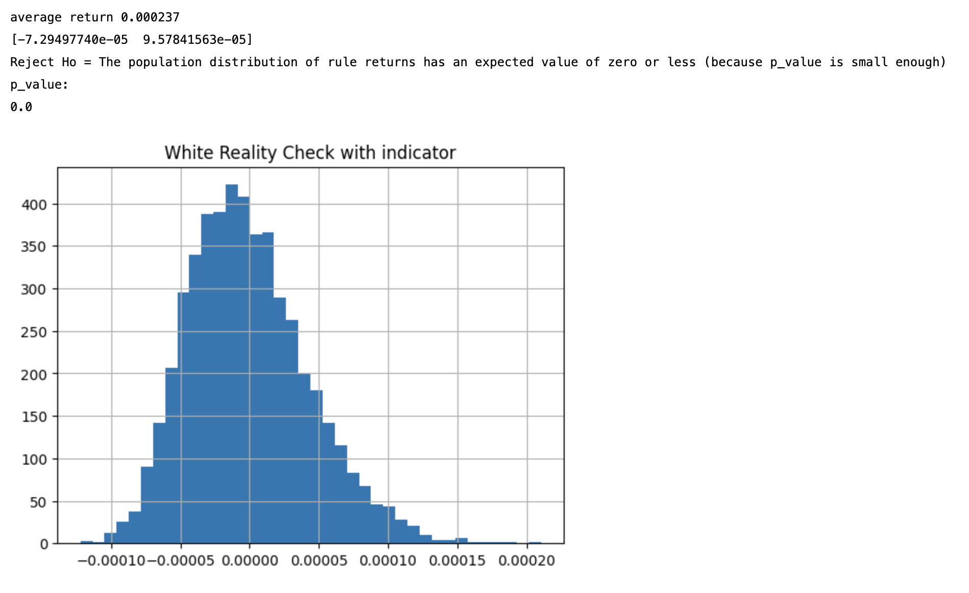
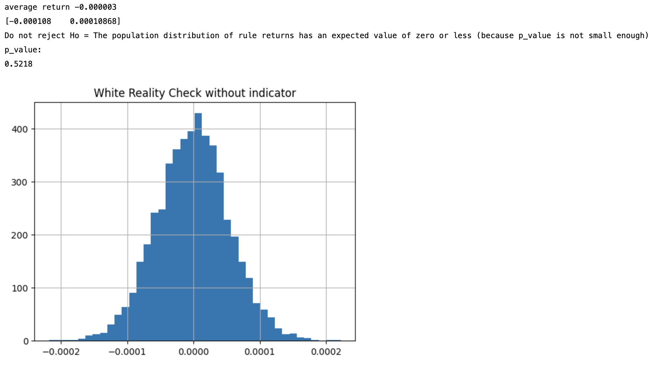
Bootstrap Result showing the increased return is not by accident
We de-trend the data, so the returns would noy be affected by the natural trend of the stock itself. Then, we bootstrap the de-trended returns to see whether our good trading system is by random.
This is called White’s Reality Check

Slide 28
Talib RSI VS Timothy RSI
After looking at the equity curve built on general, let’s select a few indicators to compare directly.
We have used RSI from both Talib and Timothy.
Lets see which output works better during the training.

Slide 29
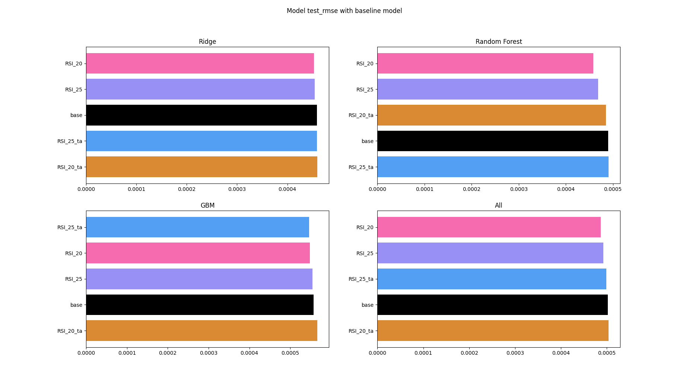
RMSE

Slide 30
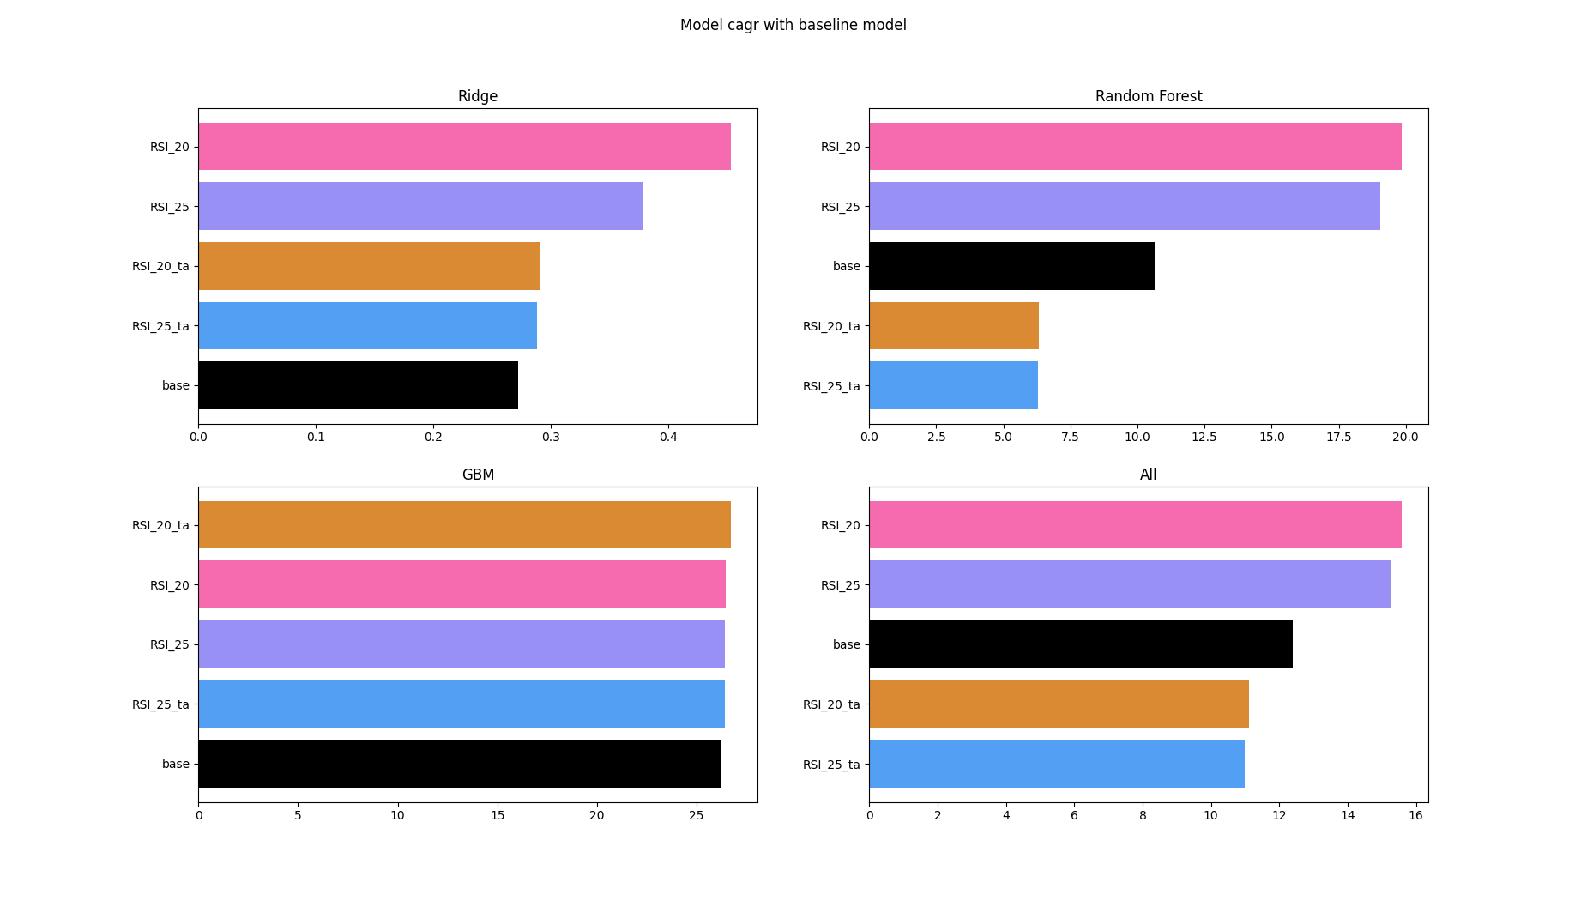
CAGR (Compounded annual growth rate)

Slide 31
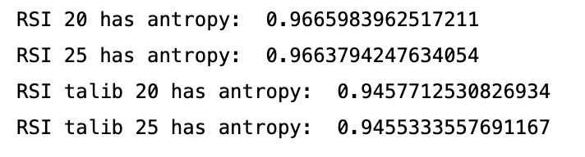
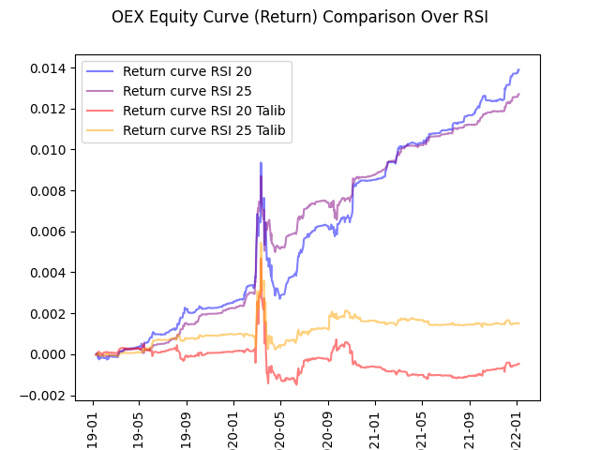
Comparison over RSI
Why there’s a difference in entropy?
Because Timothy’s indicators are transformed to maximize relative entropy! That’s extra step compared to Talib’s entropy.
Statistically speaking, Timothy’s indicators would be more “normal” than Talib’s indicators

Slide 32
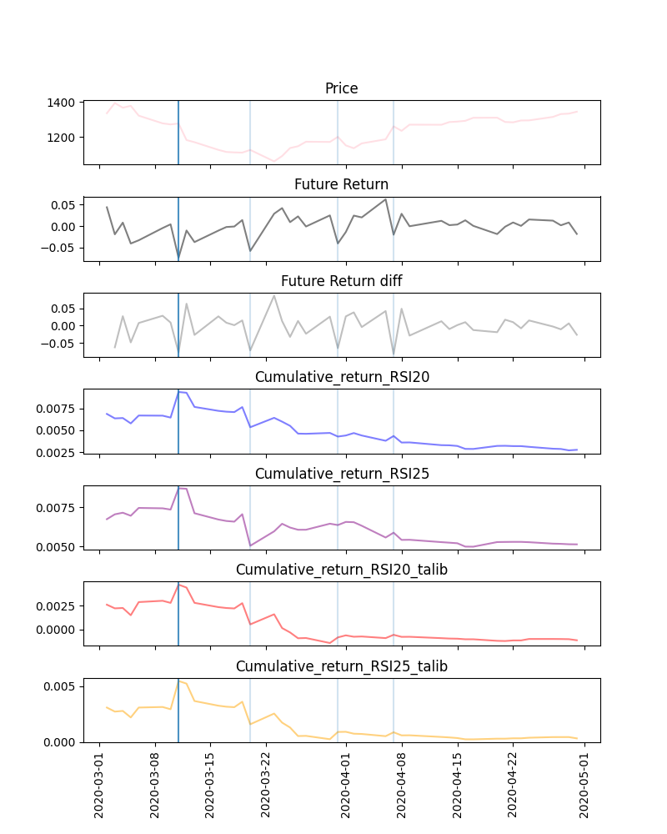

Slide 33
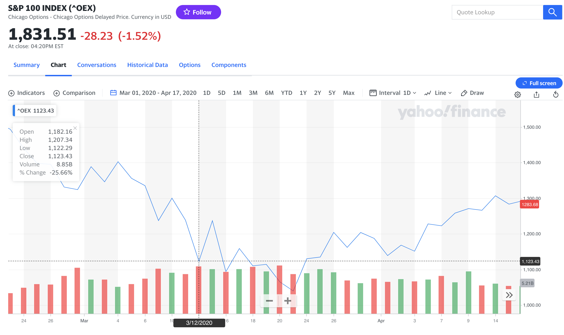
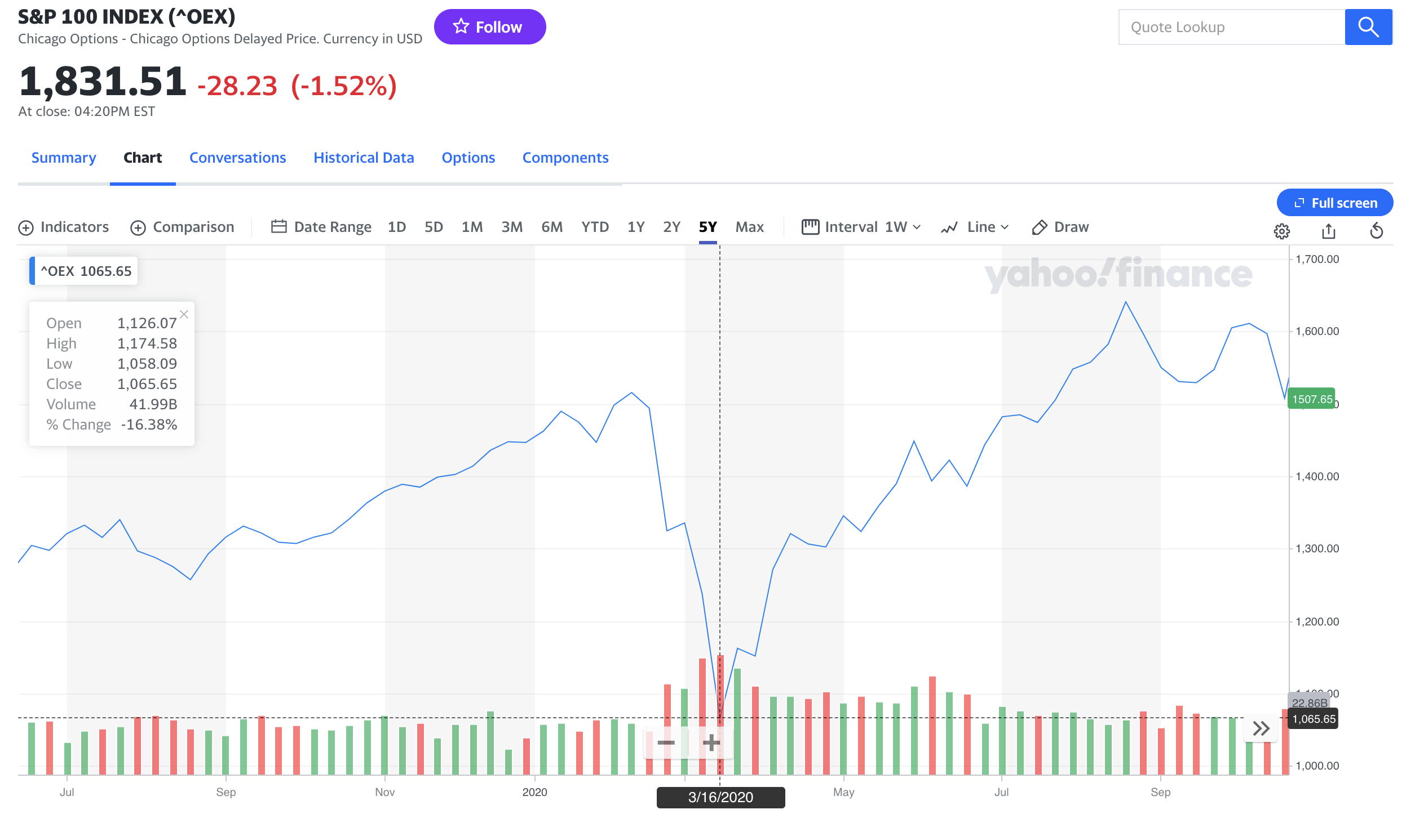
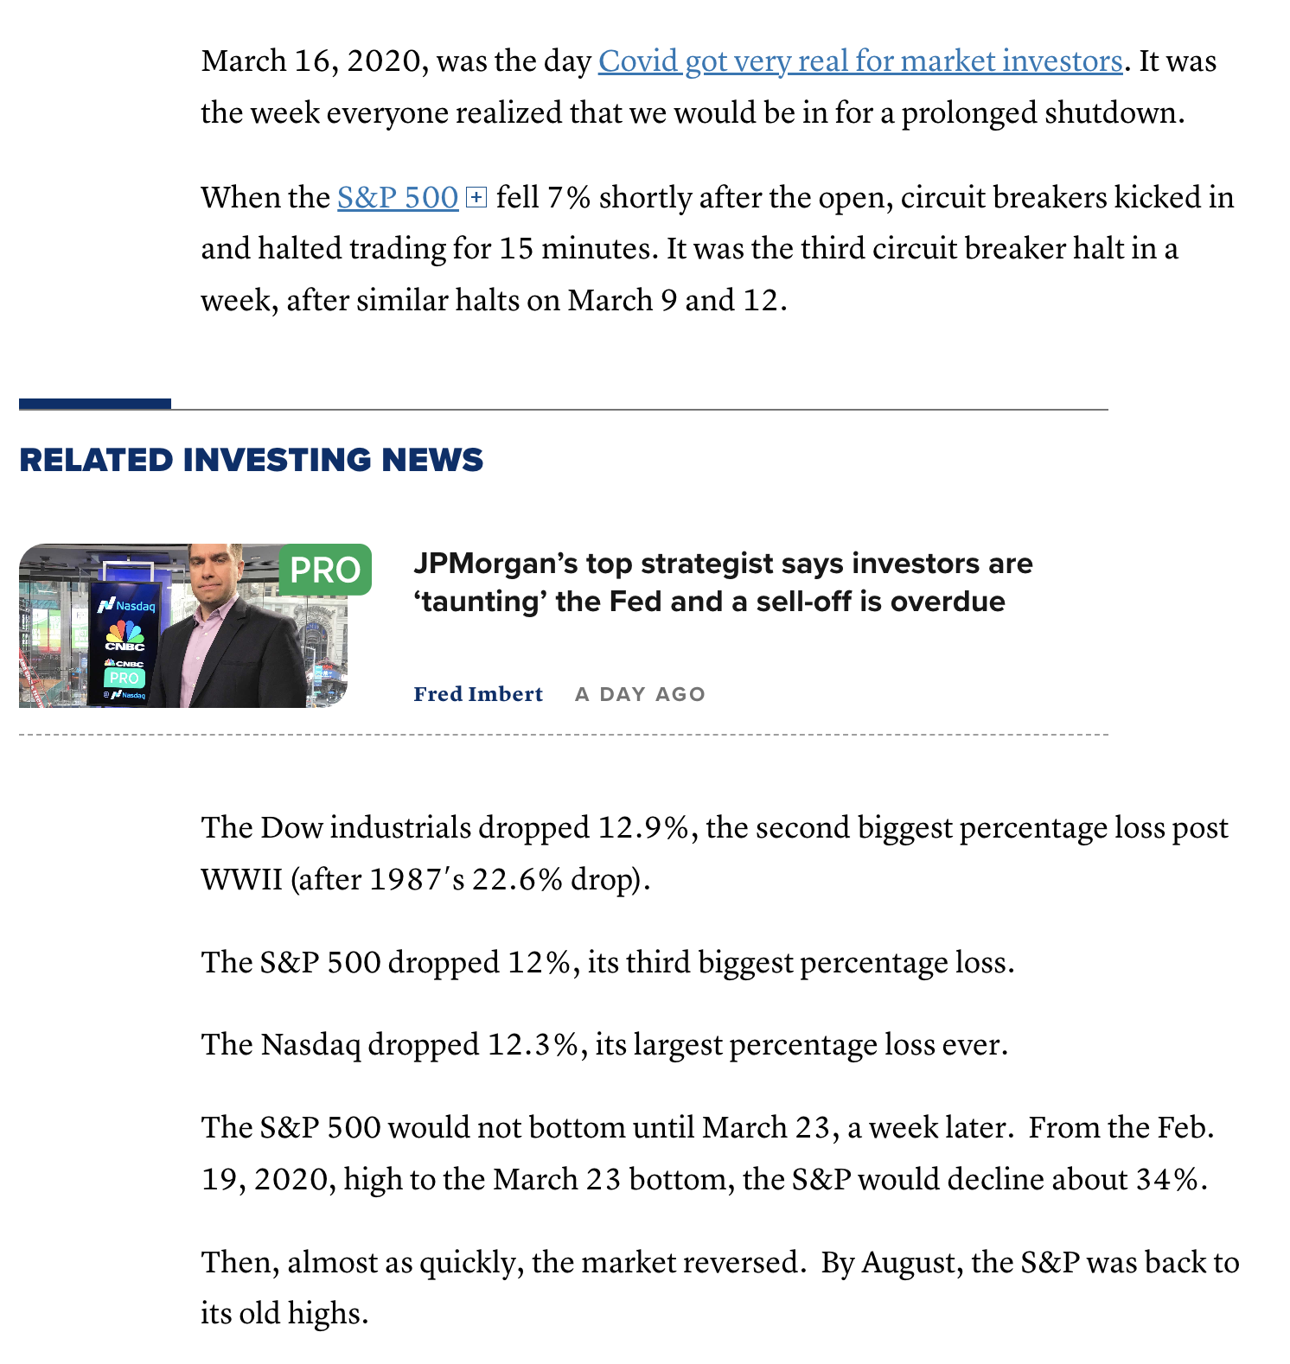
Although it spiked in week 2020-Mar-12 – Mar-16, but it is still a price crash in real life, a model pre-trained before that day would be hard to capture something like that!
From:
One year ago stocks dropped 12% in a single day. What investors have learned since then [CNBC]
PUBLISHED TUE, MAR 16 202112:24 PM EDT
UPDATED TUE, MAR 16 20211:37 PM EDT

Slide 34
Future Work

Slide 35
Future Work (indicators)
More tickers can be used, and try to impose different models for Mean Reversion Stocks, and general stocks.
The project only focus on the single indicator, but there are more indicators in the book that we can use, such as paired signals or multi-signals(multiple signal indicators for the same model(trading system) ). We can use such signals to enrich our dataset and compare the effect of each indicators.
The other way of generating more indicators, is by adding, subtracting stocks and apply the single indicator on those grouped data. The result of that can be used for a paired trading algorithm.
The indicators used in the project are limited, and we can try more different parameters for indicators with different lookback windows and different options.

Slide 36
Future Work (models)
More powerful models should be considered, like light GBM, extreme GBM or ANN and RNN or LSTM for the time series prediction. Sklearn does not do best on parallel computing and implementation is not the best.
A longer periods can be used to build a more solid trading strategy, especially when we have LSTM those models.
Other than applying more high-end models, we can include more preprocessing techniques, like PCA on the data to shrink the size and reduce the training time.
A more complete region of parameter space should be defined for tuning the models, especially for gradient boosting machine and random forest.

Slide 37
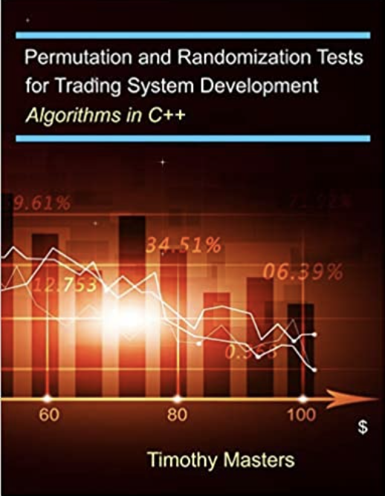
Future Work (Analysis)
Entropy analysis should be considered more carefully. Including more meaningful binning of entropy to better measure the quality of our indicators. Entropy can be incorporated into the data preprocessing.
Different models can be used for different indicators with different entropy.
LIME can be used to detect single observation, and that can help us better explain the impact our indicators bring.
Monte-Carlo Permutation Testing can be included to compare our trading system.
The algorithm of such testing is in Dr Masters’ book <Permutation and Randomization Tests for Trading System Development: Algorithms in C++>

Slide 38
Reference

Slide 39
Timothy Master: http://www.timothymasters.info/
Talib: https://mrjbq7.github.io/ta-lib/index.html
SHAP: https://shap.readthedocs.io/en/latest/
Model Explanation: https:christophm.github.io/interpretable-ml-book/
Entropy Paper: https://www.mdpi.com/1099-4300/23/5/568/htm
Entropy Blog: https://www.analyticsvidhya.com/blog/2020/11/entropy-a-key-concept-for-all-data-science-beginners/#:~:text=The%20entropy%20measures%20the%20%E2%80%9Camount,value%20of%20the%20variable%20holds.
AntroPy: https://raphaelvallat.com/antropy/build/html/index.html
Structural Entropy: https://github.com/cerlymarco/MEDIUM_NoteBook/blob/master/Structural_Entropy/Structural_Entropy.ipynb
Stock Selection: https://www.fool.com/investing/stock-market/types-of-stocks/safe-stocks
https://www.cnbc.com/2021/03/16/one-year-ago-stocks-dropped-12percent-in-a-single-day-what-investors-have-learned-since-then.html
ChatGPT

Slide 40
Q&A

Slide 41
Thank Dr. Timothy masters for joining us today

Slide 42
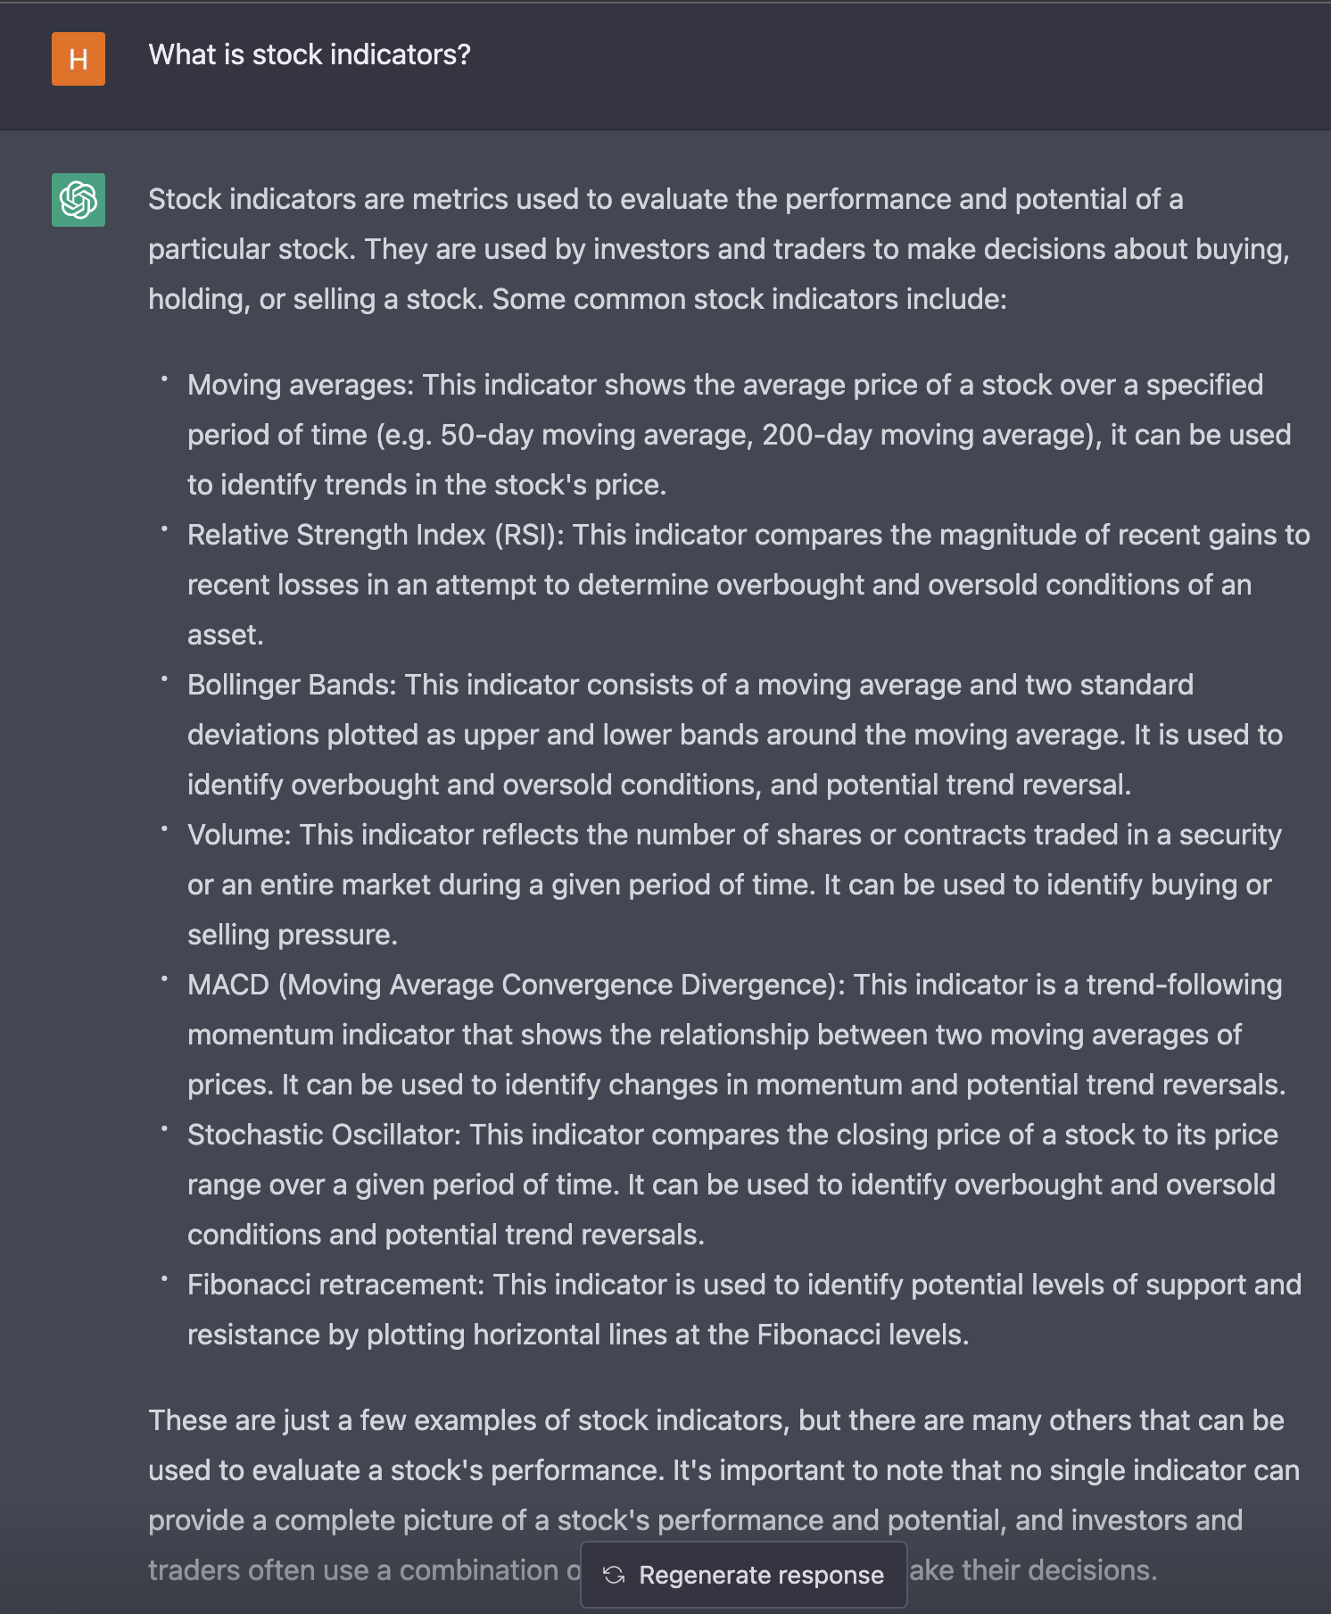
What are Indicators
Moment indicators are technical analysis tools
used to determine the strength or
weakness of a stock's price.
Few examples: RSI, MACD, Stochastic
Volatility Indicators.
Volume Indicators.
Indicators do not just belong to one categories.

Slide 43
Relative Strength Indicator RSI
The indicator is developed by J. Welles Wilder Jr.
It is a momentum indicator that measures recent price changes.
Momentrum indicators are technical analysis tools used to determine the strength or weakness of a stock's price.
It can be used as short-term buy/sell signal.

Slide 44
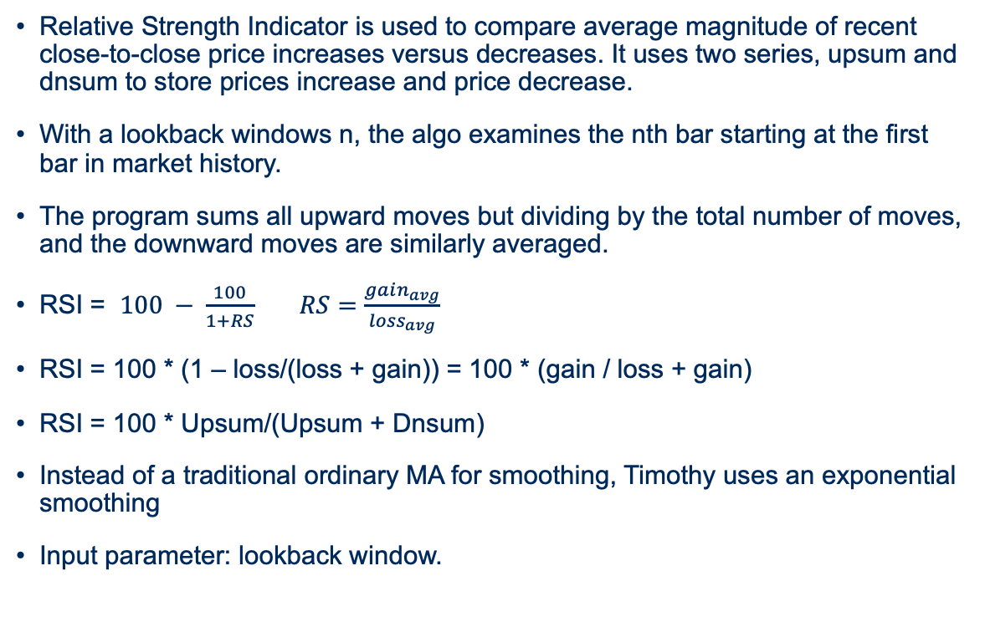
RSI
Relative Strength Indicator is used to compare average magnitude of recent close-to-close price increases versus decreases. It uses two series, upsum and dnsum to store prices increase and price decrease.
With a lookback windows n, the algo examines the nth bar starting at the first bar in market history.
The program sums all upward moves but dividing by the total number of moves, and the downward moves are similarly averaged.
RSI = $100 − \frac{100}{1+RS}$ $RS=\frac{gain_{avg}}{loss_{avg}}$
RSI = 100 * (1 – loss/(loss + gain)) = 100 * (gain / loss + gain)
RSI = 100 * Upsum/(Upsum + Dnsum)
Instead of a traditional ordinary MA for smoothing, Timothy uses an exponential smoothing
Input parameter: lookback window.

Slide 45
RSI
Low RSI levels, below 30, generate buy signals and indicate an oversold or undervalued condition (sold below its true value).
High RSI levels, above 70, generate sell signals and suggest that a security is overbought or overvalued (sold over its true value).
If RSI close to 50, it is a neutral position.

Slide 46
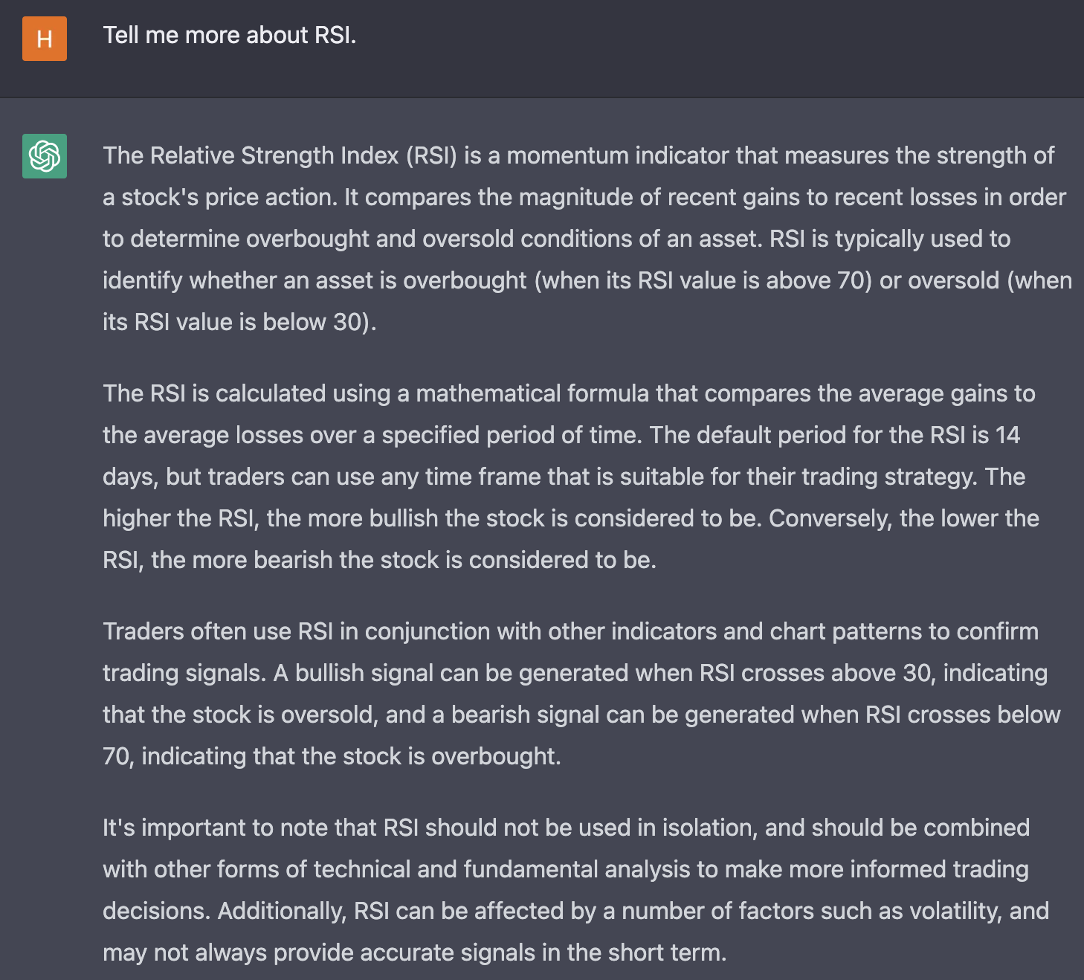

Slide 47
DT_RSI
Detrend RSI is a special RSI with a detrended.
Mean reversion is the scenarios that a stocks suddenly jump out of line and then recovers to normal trend, there may be a few reasons behind it, like seasonality, it happens a lot in service industries or energy industries.
The program will compare the market with its expectation, and it can better capture those stocks’ sudden jump. However, dt_rsi is normally negatively correlated with the market behavior in short term.
Input parameter: lookback being detrended, lookback for detrended, number of bars for linear model

Slide 48
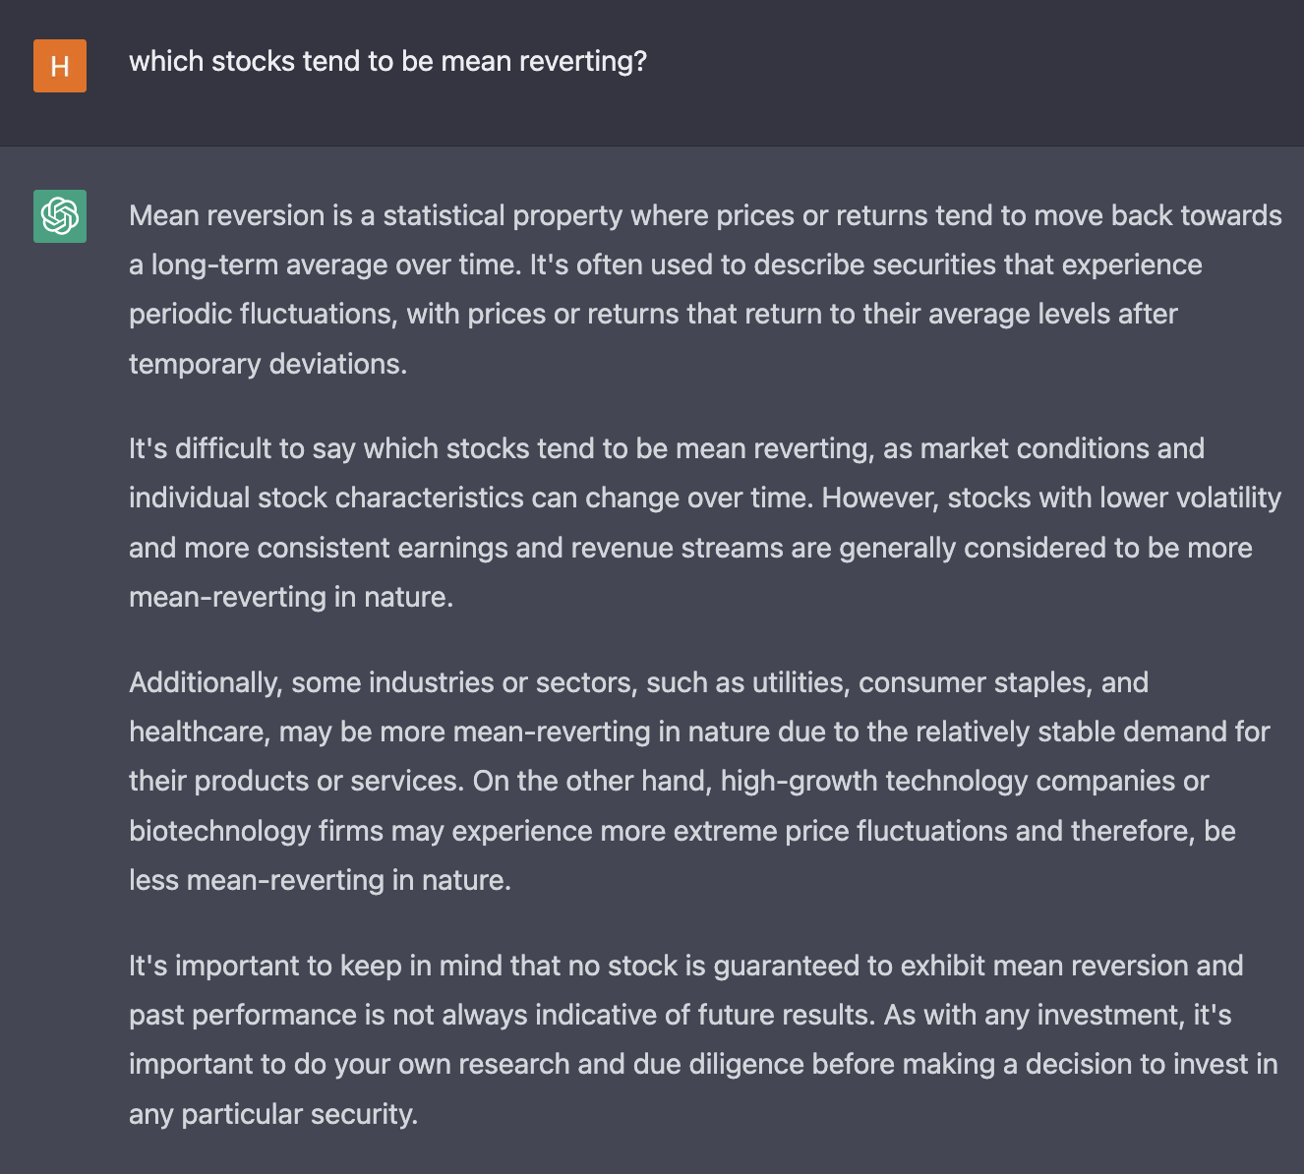
Mean Reverting stocks
Bank, Energy, Coffee, Airlines, those ones with seasonal tend to be mean reverting.
So traditional trend indicators may not
work well with MR stocks.
There are a lot of ways to distinguish
mean reverting stocks.

Slide 49
Moving Average Difference MADIFF
It calculates difference between two Moving average with different lookback windows
Input parameter: short-term lookback, long-term lookback, lag for long-term lookback

Slide 50
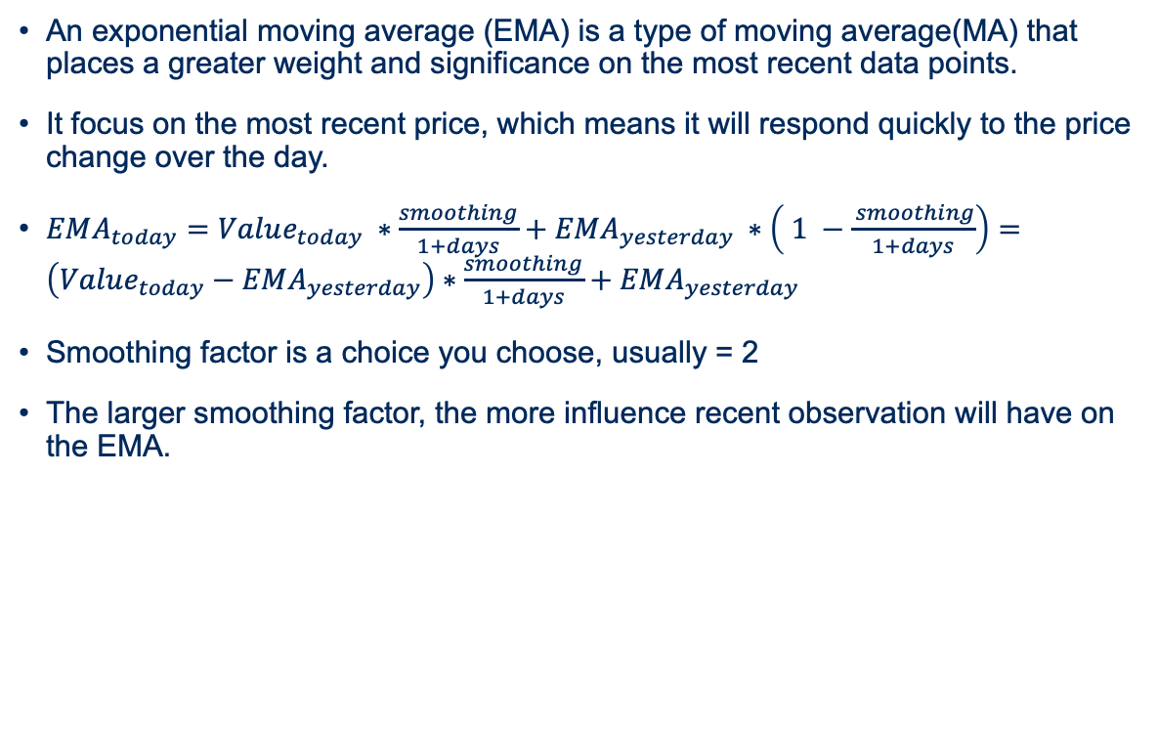
Exponential Moving Average (EMA)
An exponential moving average (EMA) is a type of moving average(MA) that places a greater weight and significance on the most recent data points.
It focus on the most recent price, which means it will respond quickly to the price change over the day.
$EMA_{today}=Value_{today} ∗\frac{smoothing}{1+days}+EMA_{yesterday} ∗\left( 1 −\frac{ smoothing}{1+days}\right)=\left(Value_{today}−EMA_{yesterday}\right)∗\frac{smoothing}{1+days}+EMA_{yesterday}$
Smoothing factor is a choice you choose, usually = 2
The larger smoothing factor, the more influence recent observation will have on the EMA.

Slide 51
Moving Average Convergence/Divergence MACD
It shows two EMA of the same security by subtracting the long term from the short term EMA.
MACD is positive whenever the 12-period EMA is above the 26-period EMA and negative when 12-period EMA is below 26-period EMA.
It is used similarly with MADiff. Instead of being computed using simple moving average, exponential smoothing is used to compute short-term and long-term moving averages.

Slide 52
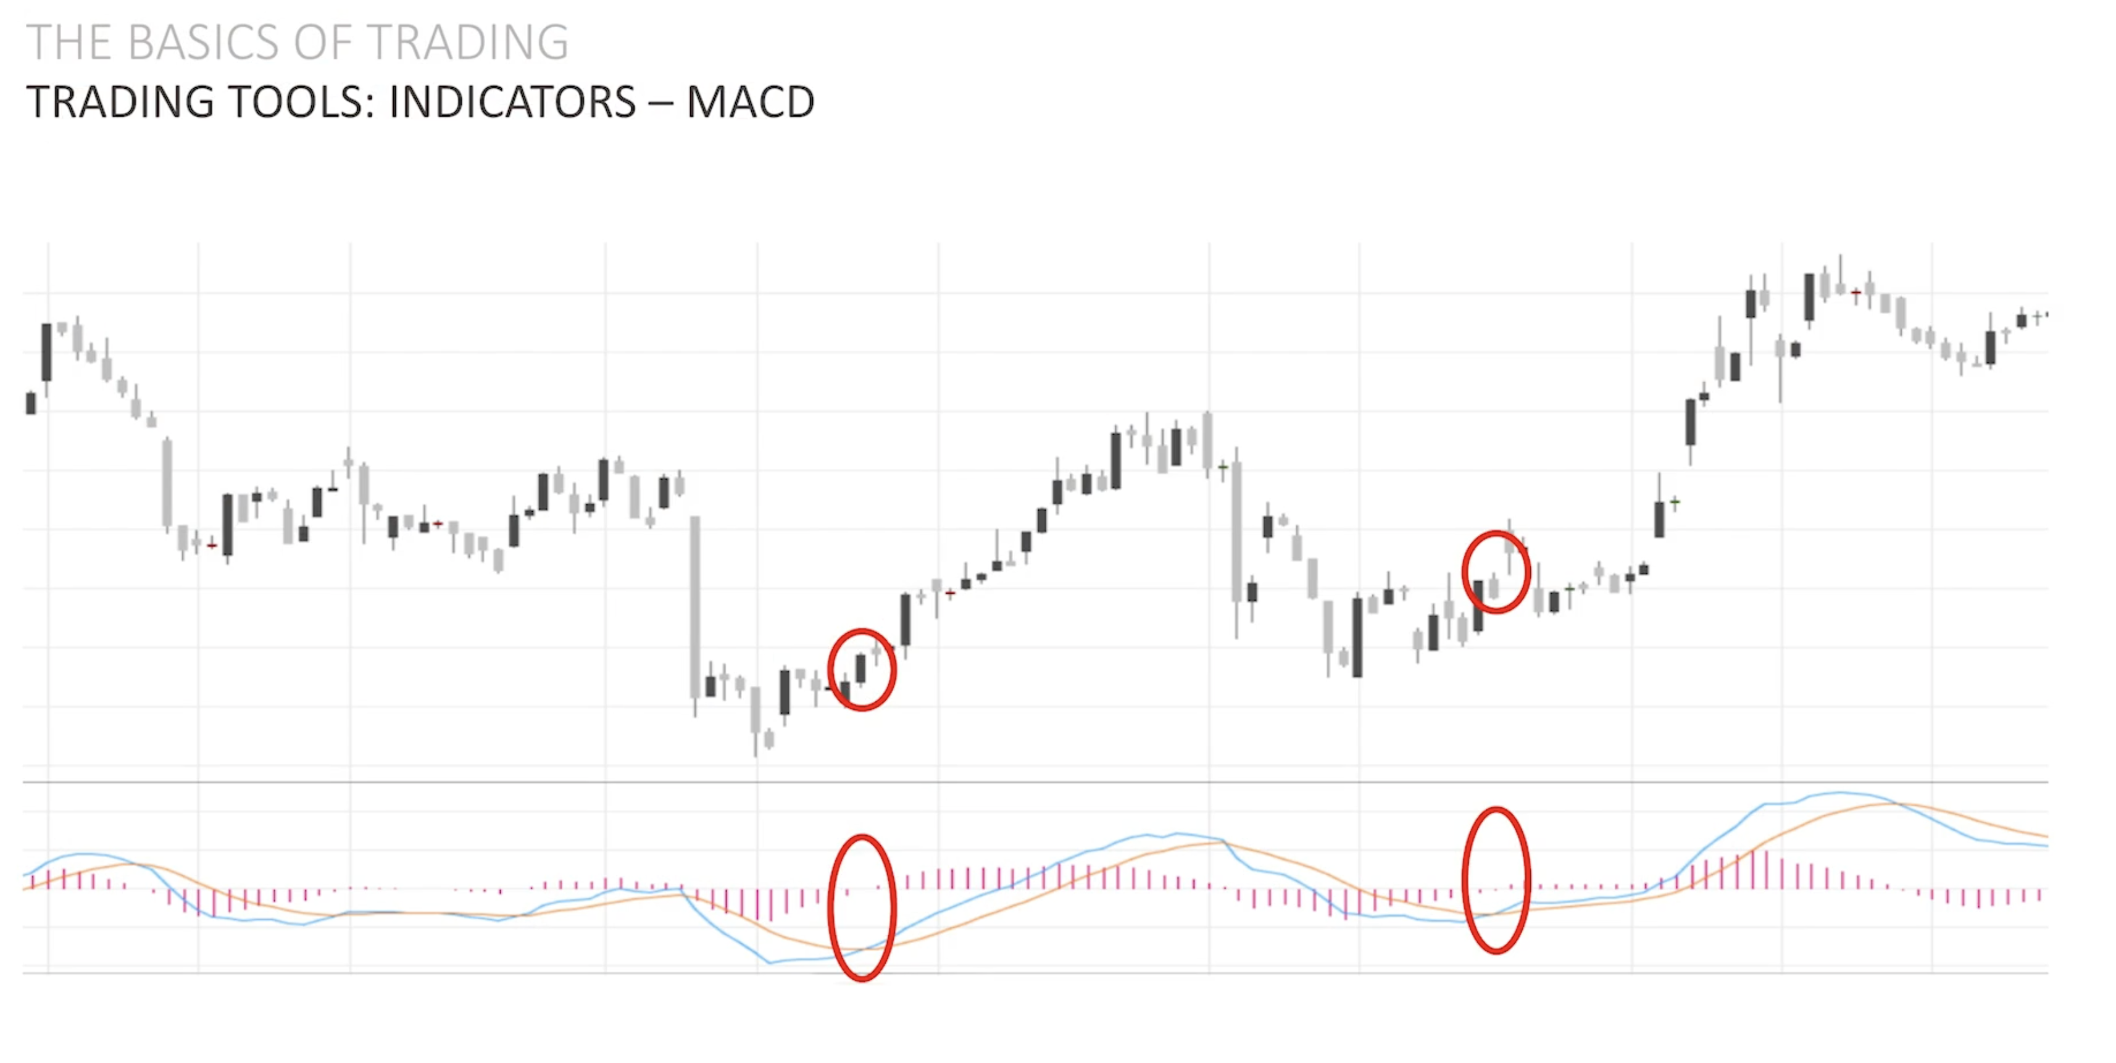
MACD
MACD can help gauge whether a security is overbought or oversold, alerting traders to the strength of a directional move, and warning of a potential price reversal.
It does not tell concrete overbought/oversold levels like the RSI. Rather, they function on a relative basis. That’s to say an investor or trader should focus on the level and direction of the MACD/signal lines compared with preceding price movements in the security at hand.
From negative -> positive indicates an entry signal

Slide 53
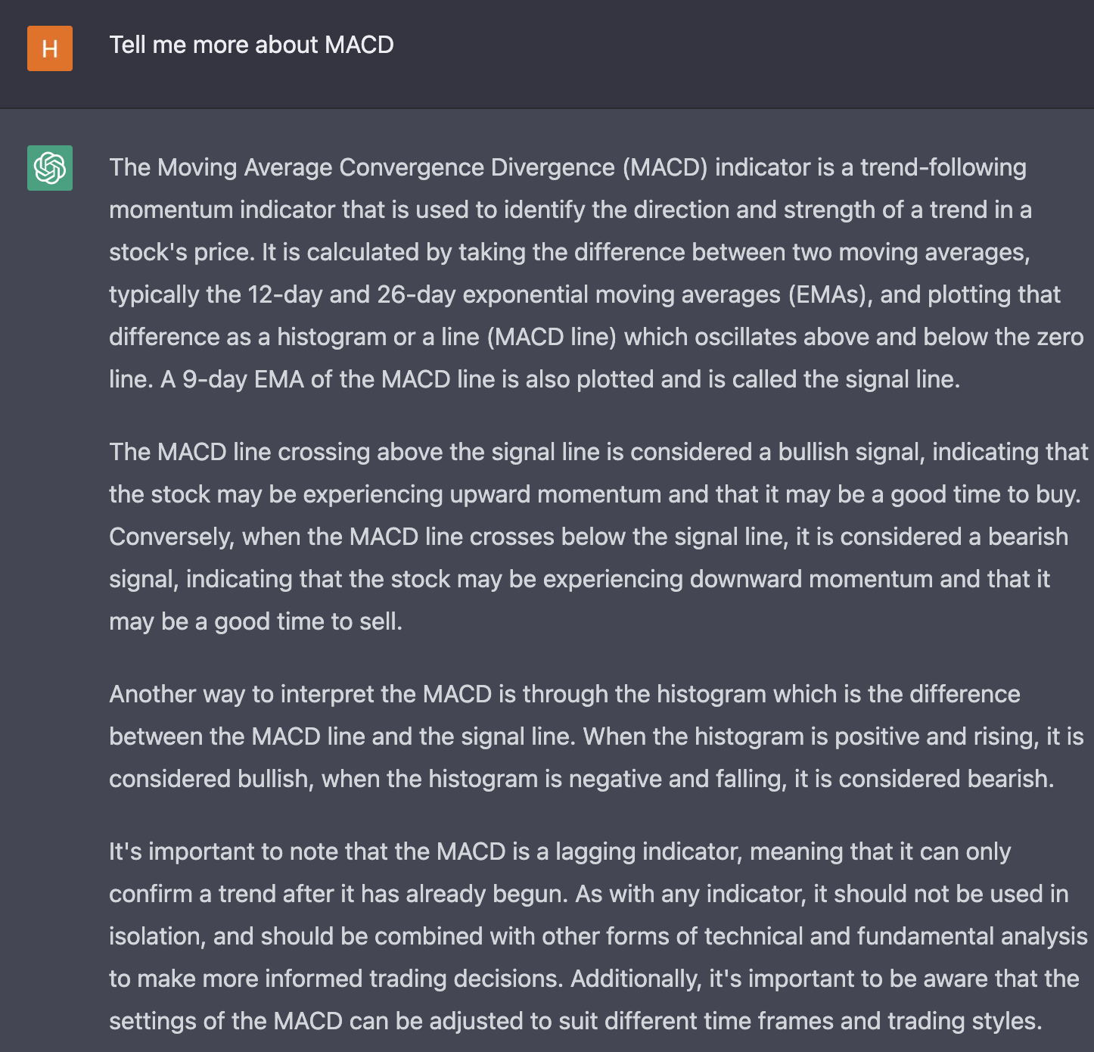

Slide 54
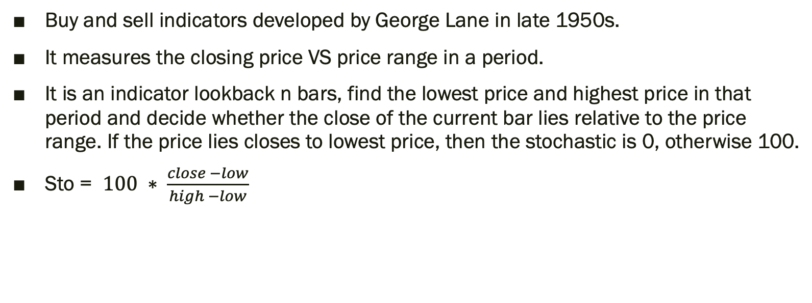
Stochastic STO
Buy and sell indicators developed by George Lane in late 1950s.
It measures the closing price VS price range in a period.
It is an indicator lookback n bars, find the lowest price and highest price in that period and decide whether the close of the current bar lies relative to the price range. If the price lies closes to lowest price, then the stochastic is 0, otherwise 100.
Sto = $100 ∗ \frac{close −low}{high −low}$

Slide 55
STO
In a upward-trending market, closing price tend to be high-end of the day’s range.
In a downward-trending market, closing price tend to be low-end of the day’s range.
Normally, if STO > 80, it means a overbought, and is a sell signal, and if STO < 20, it’s a oversold and behave as a buy signal.

Slide 56
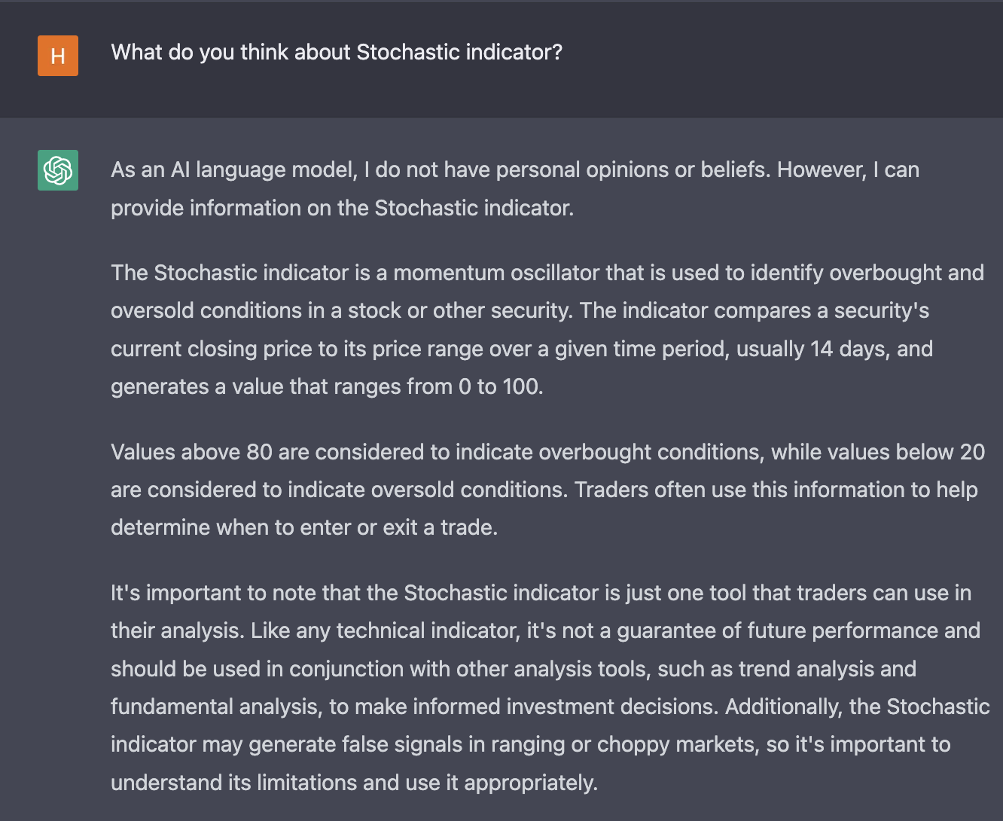

Slide 57
Price Intensity PR_INT
Price Intensity as one of the most successful indicator in our project.
It is an indicator for a bar is the open-to-close price change relative to the range of prices for this bar and close of the prior bar.
It depends on the intraday intensity, which developed by David Bostian. it examines the intraday price movement and the volume that accompanies that price movement.
Since the volume is included, normalizing intraday intensity for different markets and different time periods can be demanding. Hence Dr. Timothy introduced an alternative indicator, price intensity, without the volume component.

Slide 58
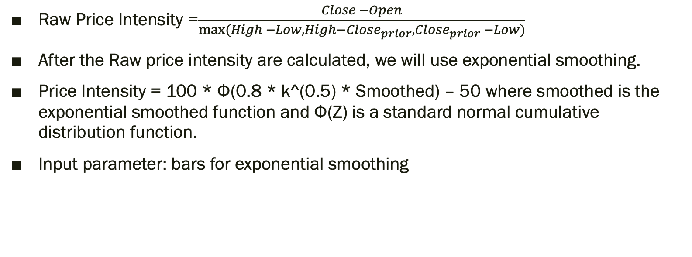
PR_INT
Raw Price Intensity =$\frac{Close −Open}{max⁡(High −Low, High−Close_{prior}, Close_{prior} −Low)}$
After the Raw price intensity are calculated, we will use exponential smoothing.
Price Intensity = 100 * Φ(0.8 * k^(0.5) * Smoothed) – 50 where smoothed is the exponential smoothed function and Φ(Z) is a standard normal cumulative distribution function.
Input parameter: bars for exponential smoothing

Slide 59
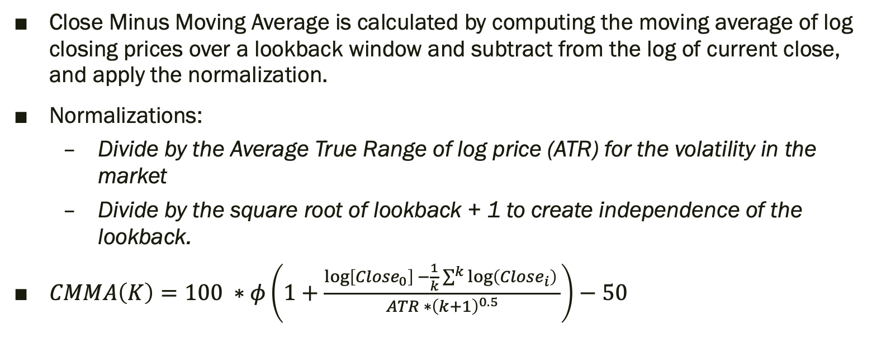
Close Minus Moving Average CMMA
Close Minus Moving Average is calculated by computing the moving average of log closing prices over a lookback window and subtract from the log of current close, and apply the normalization.
Normalizations:
Divide by the Average True Range of log price (ATR) for the volatility in the market
Divide by the square root of lookback + 1 to create independence of the lookback.
$CMMA\left(K\right)=100 ∗φ\left(1+\frac{\log\left[Close_{0}\right] −\frac{1}{k}\sum^{k}{\log\left(Close_{i}\right)} }{ATR ∗{\left(k+1\right)}^{0.5}}\right)−50$

Slide 60
LINTRND
Linear trend algorithm apply a linear regression to the data and use the linear model to decide the expectation of the price.
It works similar to moving average, but using a regression model instead of a mean, this indicator is more responsive than MA

Slide 61
Entropy
The entropy measures the “amount of information” present in a variable. It is estimated not only based on the number of different values in a list, but also by the amount of outliers or uncertainty the variable holds.
Shannon Entropy Calculation: H(X) = – Σ (p_{i} * log₂ p_{i})
However, the way of defining binning can really matter and result completely different result.

Slide 62
Price Entropy ENT
The new definition of price entropy depends on a few terms, called word length and moving window according to Dr Timothy.
Word length is the number of consecutive price changes. If we have a word length = 4, then we will rely on 4 previous price comparison. If we only consider up or down, then we will have 2^4 possible combinations, and each combo will fall into one of the bins.
This way, he would only have 8 bins, and this entropy does not care about the amount of change.
Increasing price entropy indicates an increasing disorder in a price series.

Slide 63
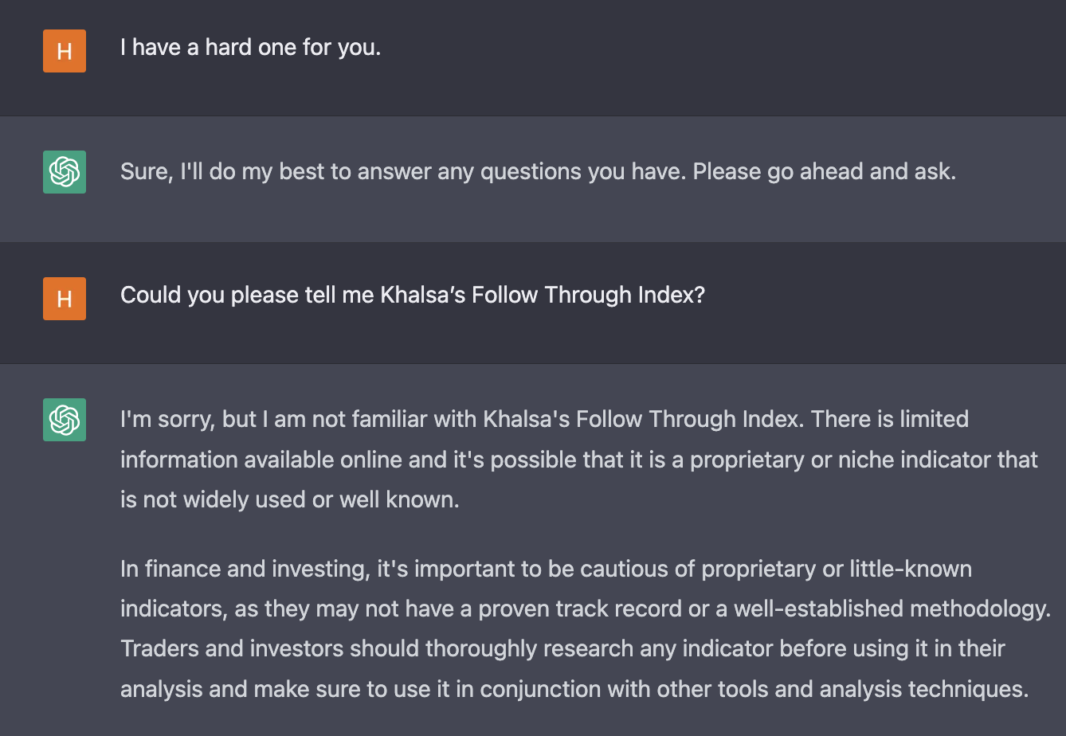
Follow Through Index FTI

Slide 64
FTI
Khalsa’s Follow Through Index
It is not a traditional indicator, not a direction, also not a rate of the trend.
It is an indicator that when the market shows a trend and did that trend continue for a long time.
When a trend stay for a long time, it will present a high FTI value.
It has a few subcategory, Lowpass Filtering,, best period, best width, and best FTI.
Input parameter: lookback window, half-length, min period search for max FTI, max period search for max FTI

Slide 65
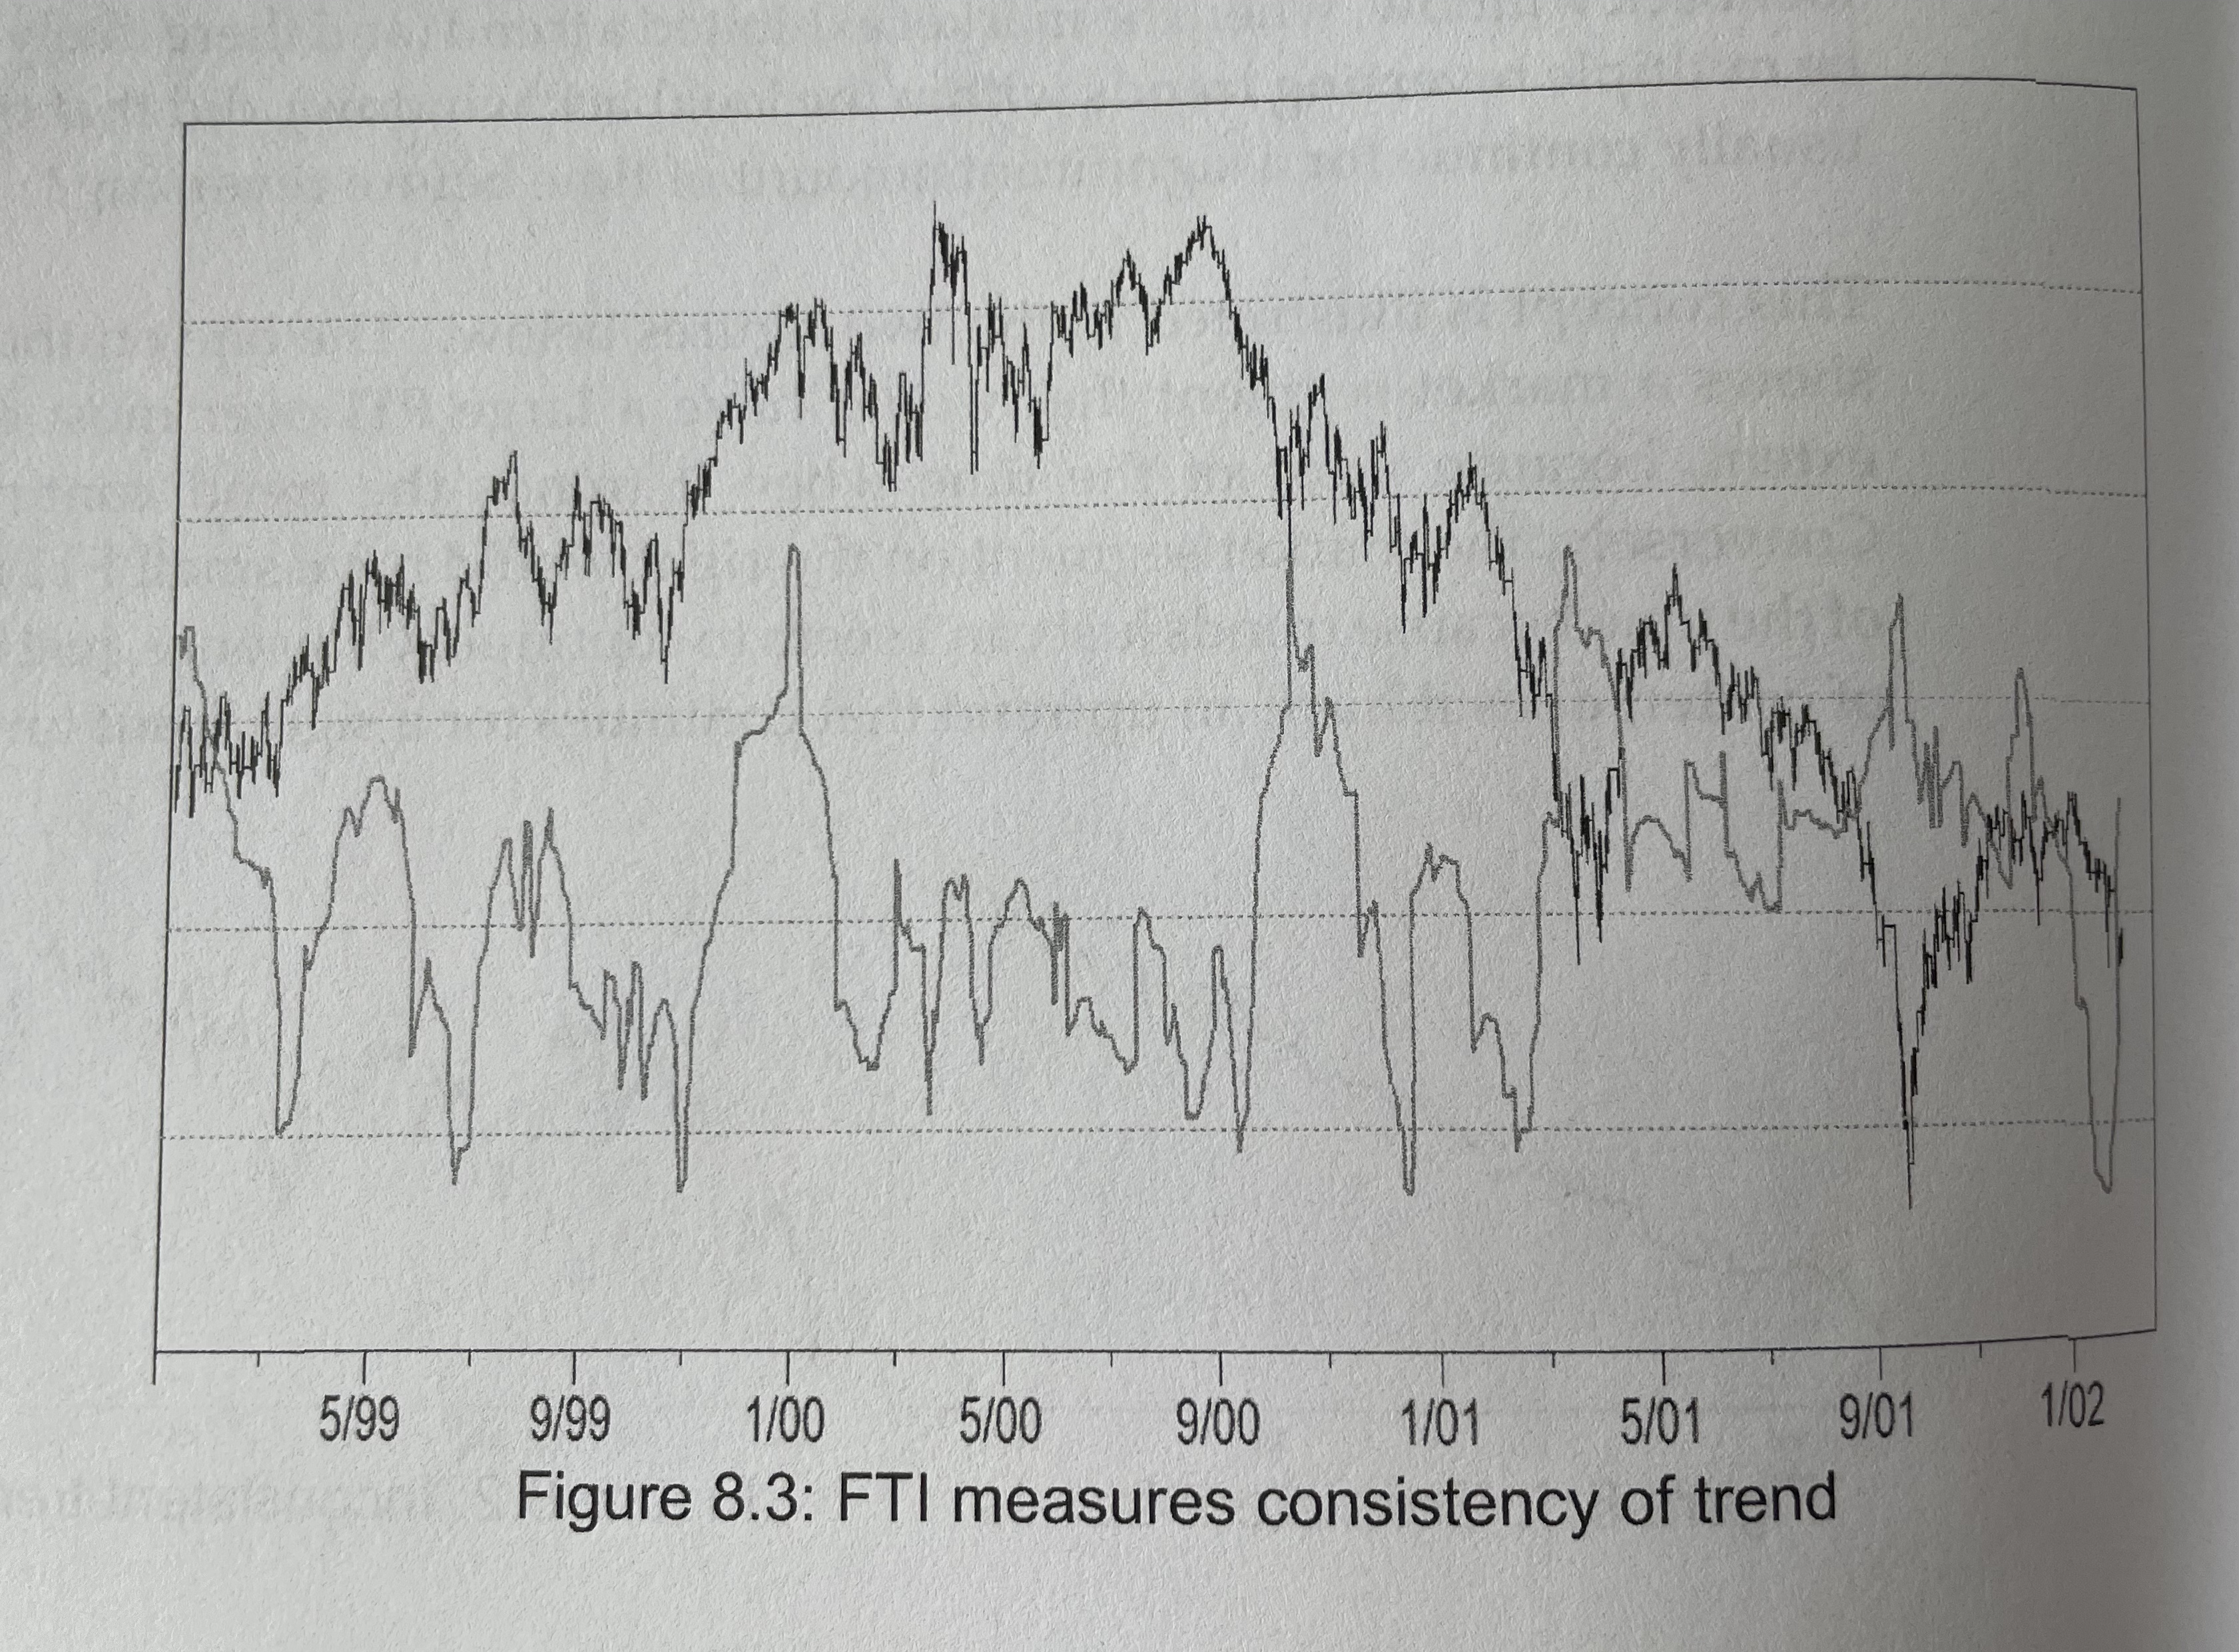
FTI
FTI usually requires a long period of lookback window.
It is a regime indicator.
It will have a high value once the trend
the trend keeps going.
However, we do not know when it will
start to drop and when to stop trading
So we better use this along with other
trend-following indicators
FTI can give you an overall good picture
of the stock/ market

Slide 66
Q&A

